Slide 1
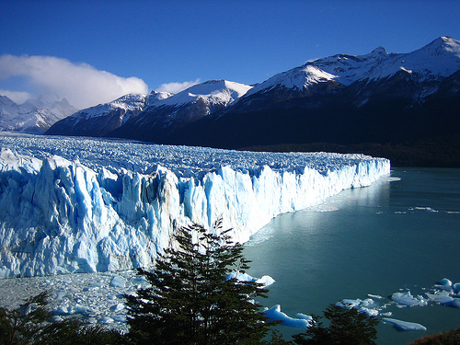
Glaciated Uplands
Higher Geography
Physical Environments: Lithosphere

Slide 2
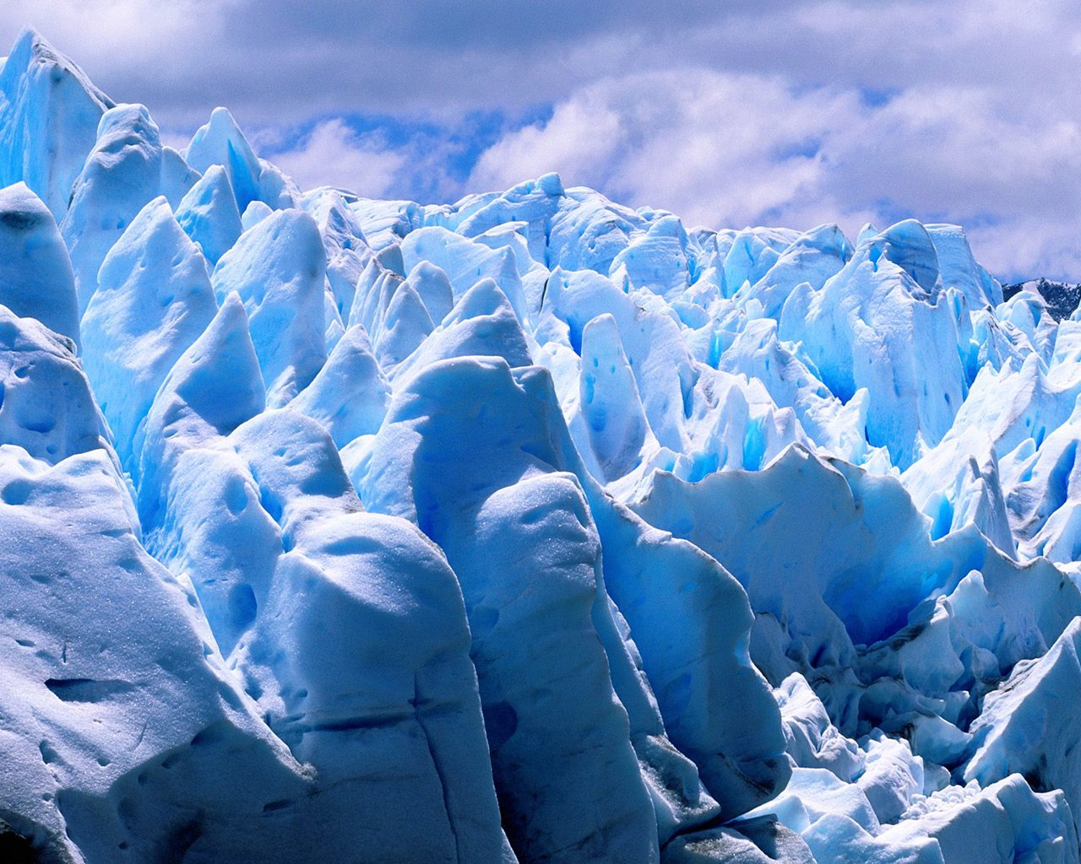
Glaciated Uplands Outline
Glacial Ice and the Glacier as a System
Features of Glacial Erosion
Features of Glacial Deposition
Identifying Glacial Features on O.S. Maps

Slide 3
Aims of the lesson
To recap the formation of glacial ice and the glacier as a system.
To revise the glacial history of the British Isles.
To revise the processes of glacial erosion.
To learn the formation of corries, arêtes & pyramidal peaks.

Slide 4
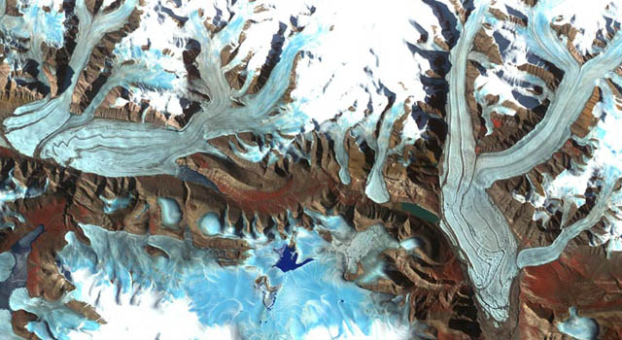

Slide 5
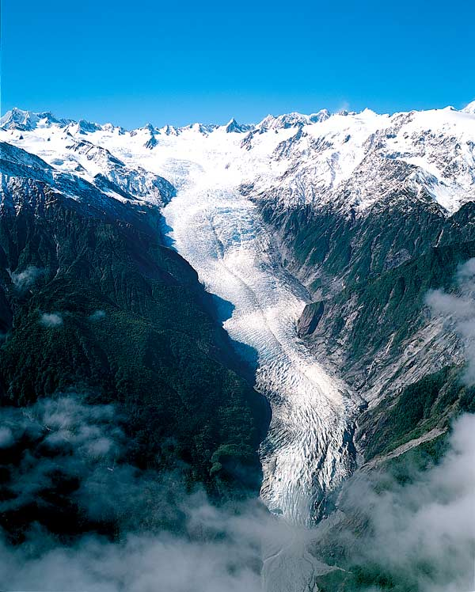
What is a Glacier?
A glacier is a large, flowing river of ice that usually moves very slowly.
Largest calving event ever seen
Slow - Metres per year.
Fast - 20m per day (Jakobshavn Isbrae - Greenland)
Athabasca Glacier, Canada

Slide 6
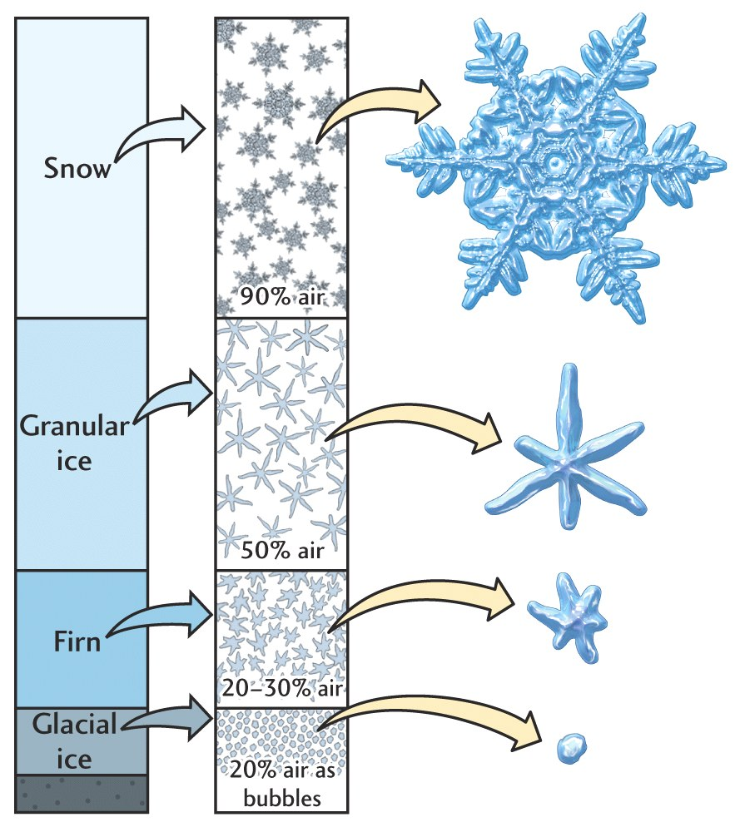
Glacier Formation
Glaciers form when snow is compressed by the weight of more snow falling on top of it.
The snow is first compressed into firn crystals.
It is then further compressed into glacial ice.

Slide 7
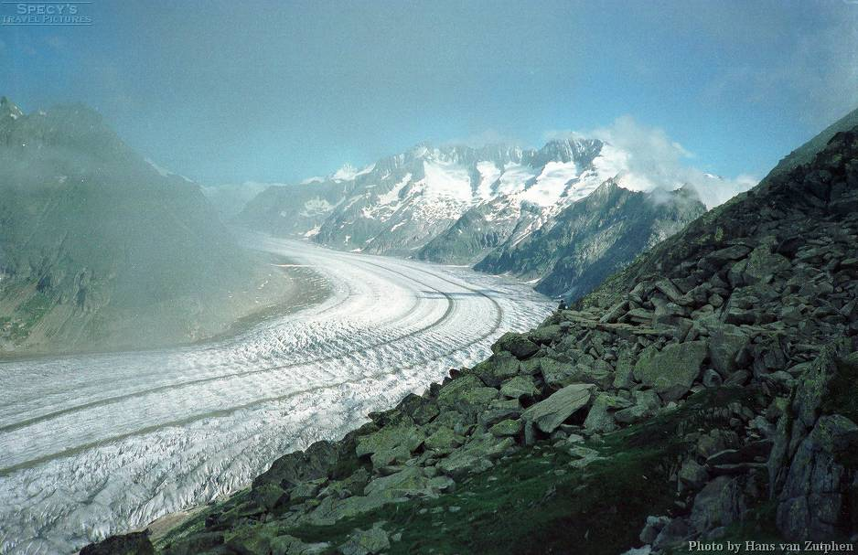
Valley Glaciers

Slide 8
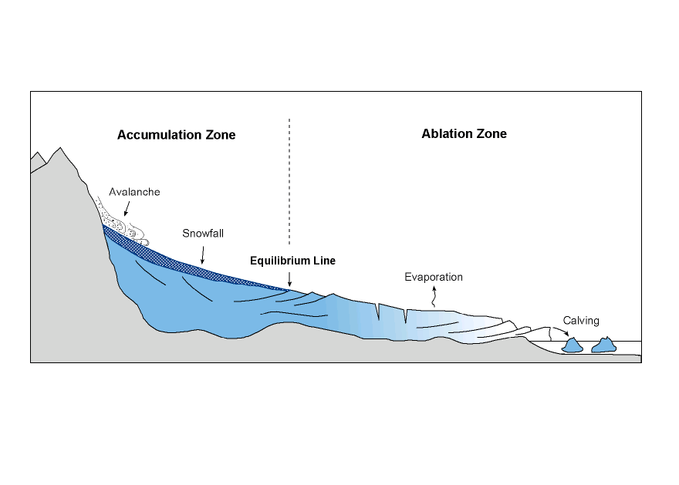
The Glacier as a System
The glacier is a system with inputs and outputs.
This is where the snow collects, turns into ice.
Melting and evaporation of glacial ice at its snout.

Slide 9
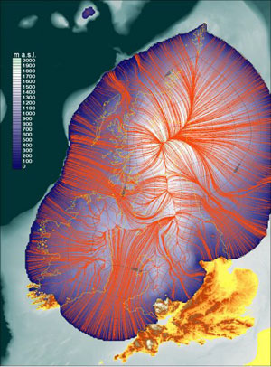
Location of Glaciated Uplands in the UK
The Pleistocene period of the ice age lasted 2½million years and has 20 different glacial and interglacial periods.
The oldest saw ice reach as far south as the Thames Severn line.
Scenery would resemble Antarctica today with 350m ice cap burying even some high mountains.

Slide 10
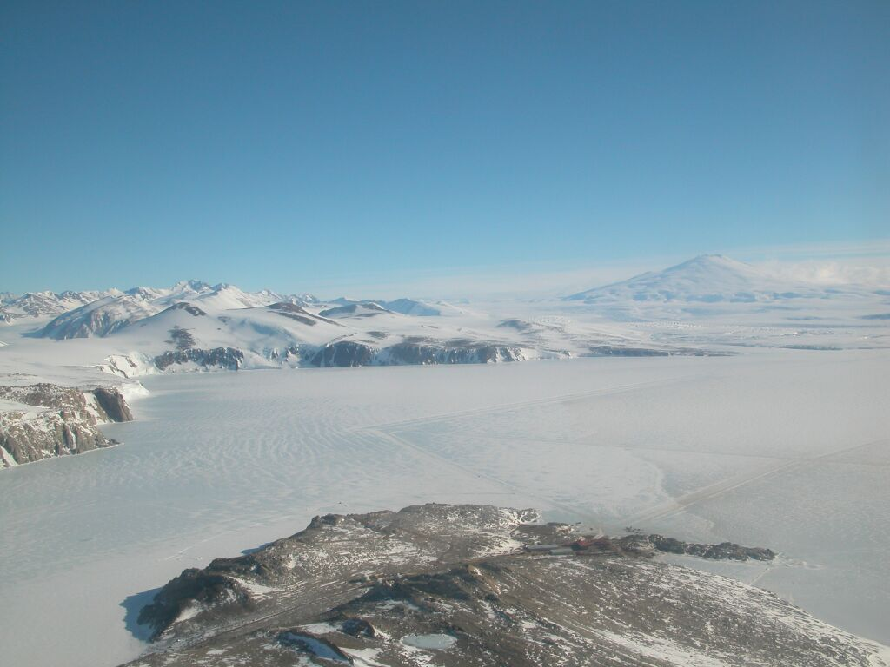

Slide 11
The last episode took place 10,000 years ago during the Loch Lomond Readvance.
Temperatures dropped by about 3-5 degrees Celsius and caused widespread erosion in the upland areas and deposition in the lowland areas.
Intensely glaciated areas like the Cairngorms, NW Highlands and the Lake District are in sharp contrast to the southern areas or lowland areas which have been deposited with glacial drift.

Slide 12
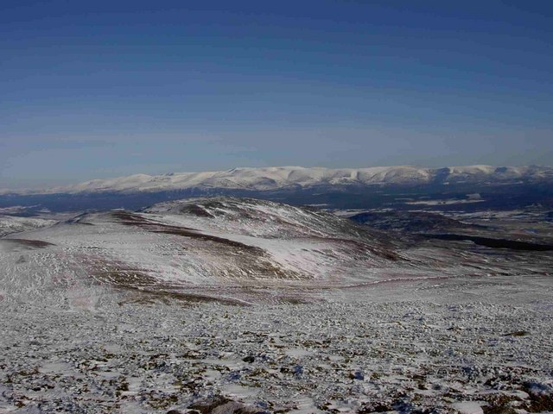

Slide 13
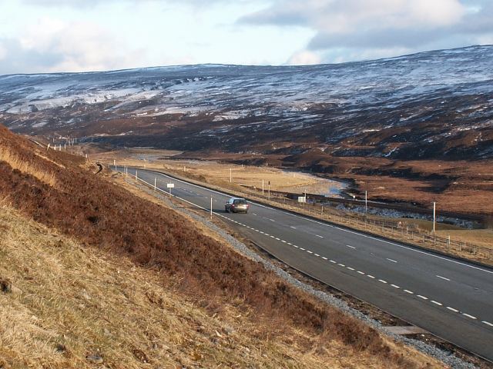

Slide 14
Processes of Glacial Erosion
Freeze Thaw (Frost Shattering)
Water in cracks in the rock freezes and expands.
After many cycles of freezing and thawing lumps of rock are
broken off.
Plucking
Glacier ice freezes into cracks in rocks and when the glacier
moves it pulls out chunks to leave a jagged surface.
Abrasion
Rocks stuck in the ice grind away the bedrock under the
glacier.

Slide 15
Freeze Thaw
Scree - rock fragments broken
off by freeze thaw (frost shattering)

Slide 16
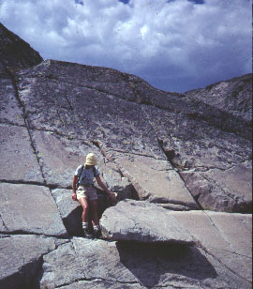
Plucking
Glacial ice melts due to friction as it goes over an obstacle like a rock mass.
This water will almost instantly refreeze because of the overlying pressure of the ice.
It re-freezes into the cracks and crevices and as the glacier moves loose pieces of rock are pulled or torn out.

Slide 17
Abrasion

Slide 18
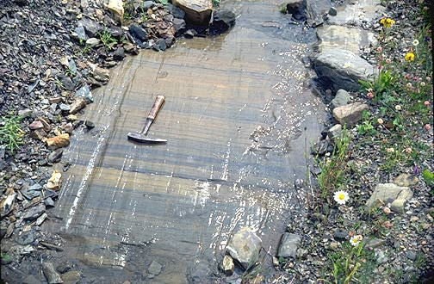
Abrasion: Striations

Slide 19
Formation of a Corrie

Slide 20
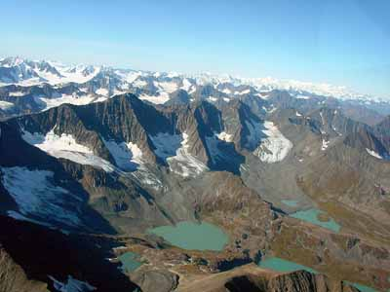

Slide 21
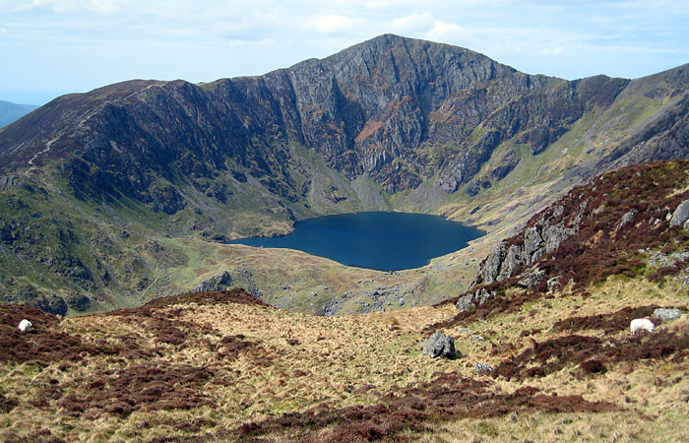

Slide 22
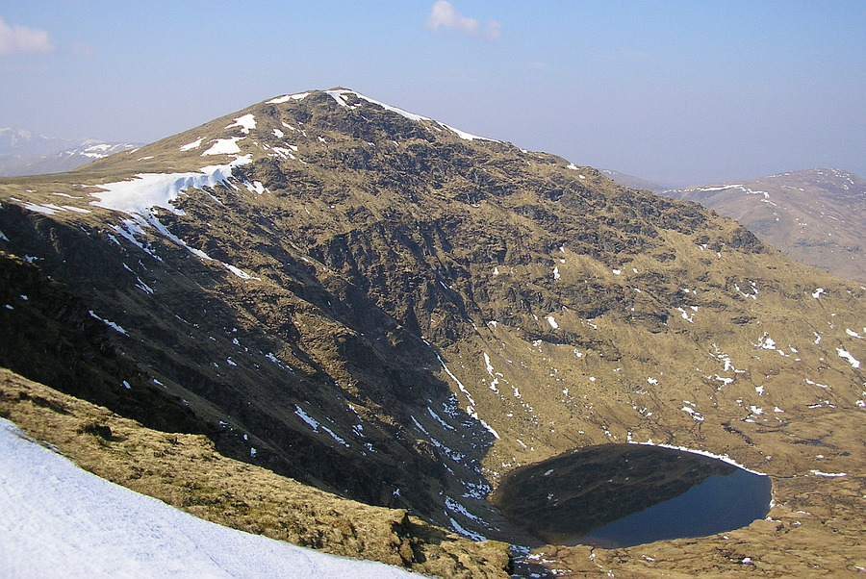
Named Example: Coire an Lochain, Cairngorms

Slide 23
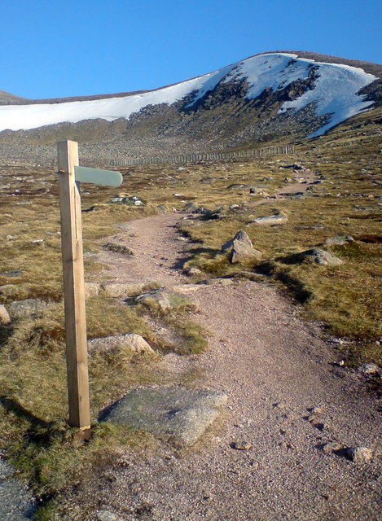
Named Example: Coire Cas, Cairngorms
Snow collects in hollows.
Snow compacts to ice.
Ice moves under gravity, lubricated by meltwater.
Ice moves by rotational sliding.
Abrasion deepens corrie.
Plucking steepens back and sides.
Corrie lochan (tarn) may fill hollow.

Slide 24
Simplification Activity
Each of you has been given a sample answer on the formation of a corrie.
Read this carefully.
On lined paper I want you to simplify it down to 6 bullet points.
You should also include an annotated diagram.
Organise your bullet points into 3 headings:
Before Glaciation
During Glaciation
After Glaciation

Slide 25
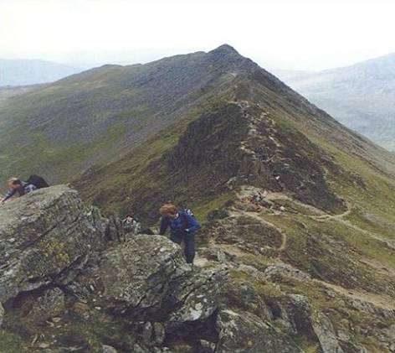
Arêtes
Arêtes are formed when 2 corries are found back to back.
Plucking and freeze thaw action erodes the backwall of both corries towards each other.
A steep knife-edged ridge of rock is created.
Named Example: Striding Edge, Lake District

Slide 26
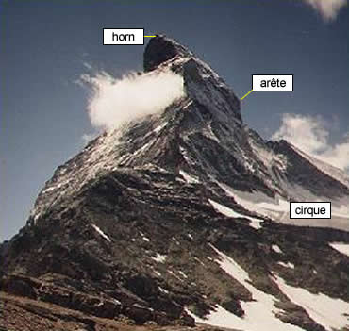
Pyramidal Peaks (Horns)
Found where 3 or more corries are located in the same mountainside.
Named Example: The Matterhorn, Swiss Alps

Slide 27
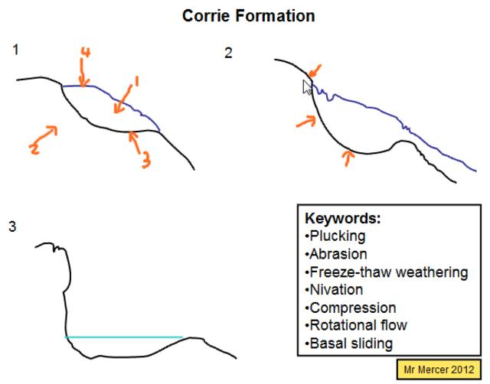
Homework
With the aid of annotated diagrams, explain the processes involved in the formation of a corrie.
(9 marks)
Tips:
Must have a well annotated diagrams (could be before, during and after glaciation),
Explanations should include processes at work e.g. abrasion, plucking, rotational sliding and their resulting effects on the land.
Refer to your diagrams throughout.
Named example!

Slide 28
Summary
So far we have…
recapped the formation of glacial ice and the glacier as a system.
revised the glacial history of the British Isles.
revised the processes of glacial erosion.
learnt the formation of corries, arêtes & pyramidal peaks.

Slide 29
Unscramble the Words!
lkpugnic
plucking
rotational slip
qrueic
taialnoort lpis
cirque
ockr pil
Coire Cas
Lake District
rock lip
oierC sCa
eLak iicDtstr
abrasion
ioaarbsn
acirelg
firn
glacier
ifrn

Slide 30
Aims of the lesson
To revise the formation of a
U-shaped Valley (Glacial Troughs),
Hanging Valley
Ribbon Loch
To learn the formation of a Roches Moutonnées
To learn the formation of a Crag & Tail

Slide 31
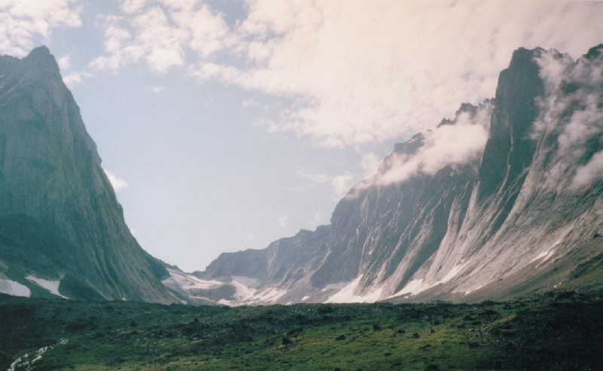
U-Shaped Valley

Slide 32
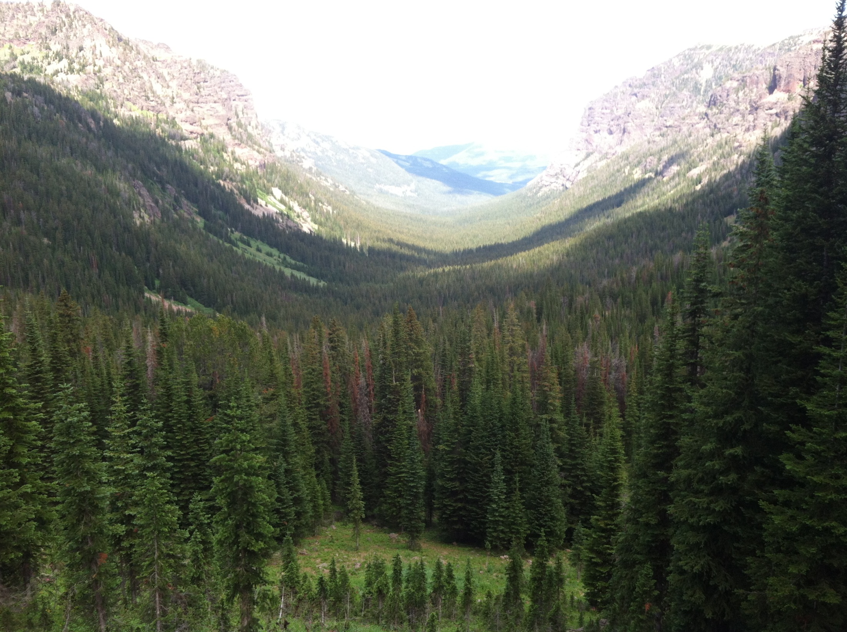

Slide 33
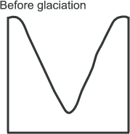
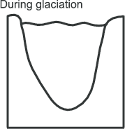
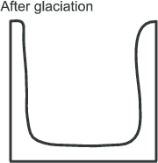
U-Shaped Valley (Glacial Trough)
When a glacier erodes its valley, a classic U shape is formed, with steep side walls and a wide flat valley floor.
U shaped valleys start life as V shaped river valleys that existed before glaciation.
Plucking and freeze-thaw action truncate spurs of rock and steepen the valley sides.
Abrasion deepens and flattens the valley floor. Over time the valley also becomes straighter.
Named Example: Glen Avon, Cairngorms

Slide 34
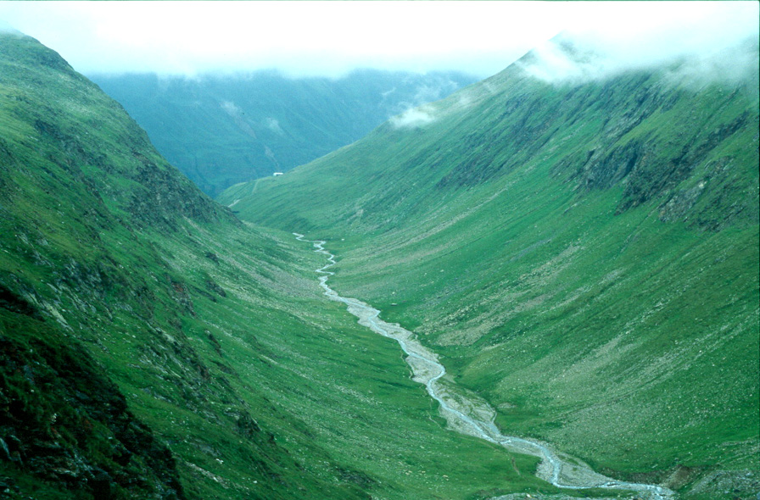
Misfit Stream
After glaciation when the ice melts, the river which originally flowed on the floor of the V-shaped valley may once again begin to flow through the U-shaped valley.
It is now called a Misfit Stream. It is so called because it looks out of place in the now large valley and also because it did not contribute to its formation.

Slide 35
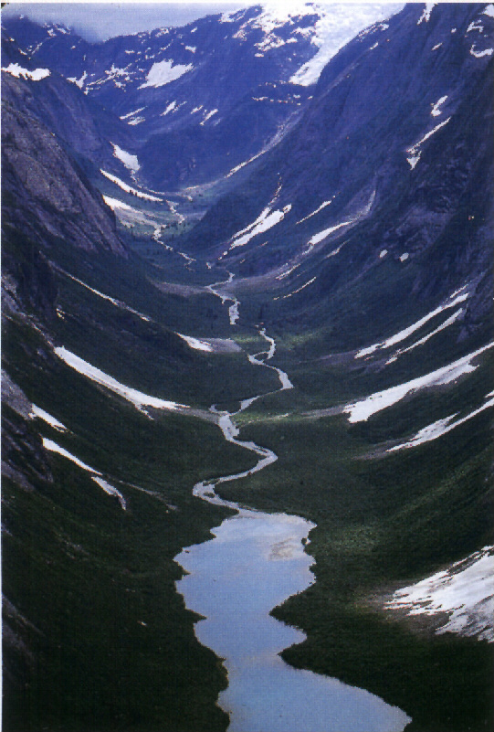
Ribbon Lochs
At some points in the U-shaped valley, glaciers erode more deeply than elsewhere because:
the rock was softer and more easily eroded
or
the ice was thicker at this point and therefore more powerful.
Where ice did this, it would create an overdeepened hollow which after glaciation filled with meltwater to become a Ribbon Loch.
The lake takes on the same shape as the valley in which it was formed – so tends to be long and quite narrow.
Named Example: Loch Avon, Cairngorms

Slide 36
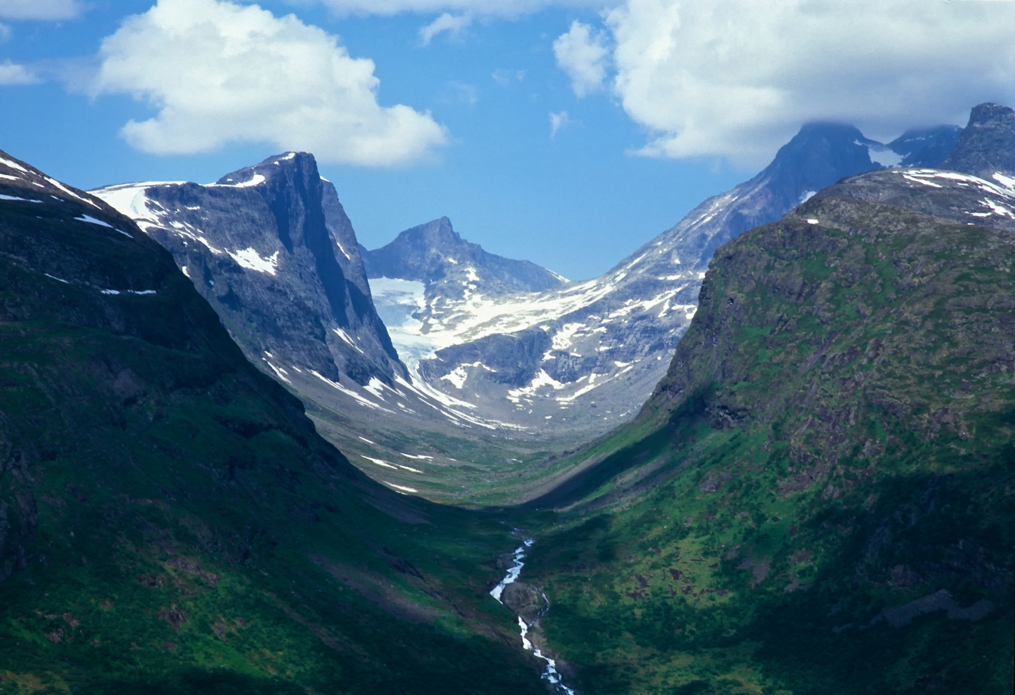
Draw an annotated fieldsketch of this landscape to show evidence of glaciation.

Slide 37
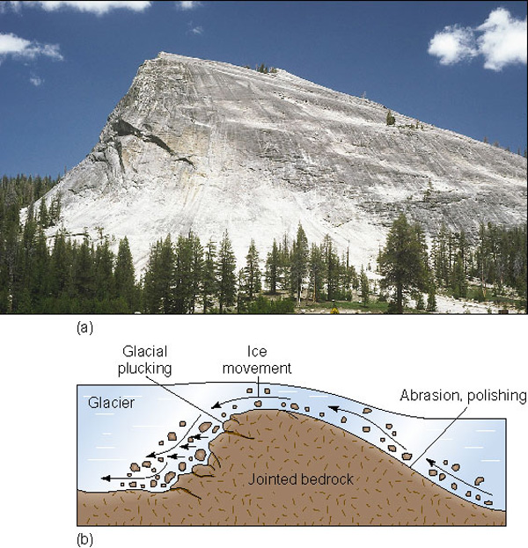
Roches Moutonnées
As a glacier flows down a valley it will encounter more resistant rock types.
If it cannot completely erode the rock it will instead smooth one side by abrasion and pluck rocks from the other.
These landforms allow us to see what direction glaciers where flowing in.
Examples found in Grantown on Spey.

Slide 38
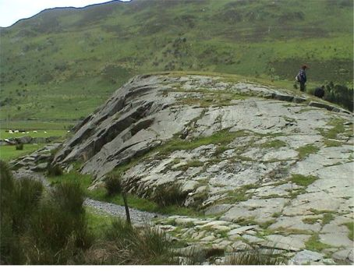

Slide 39
Diagram Memory Activity
In groups, you are going to learn about the formation of a roches moutonnées.
Each of you will create an exact copy of my diagram.
You will come up to the front in turns and bring back information to your group.

Slide 40
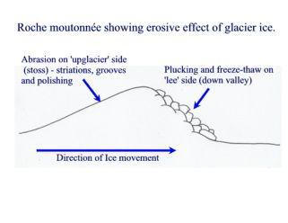

Slide 41
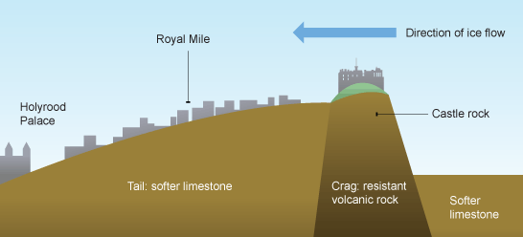
Crag & Tail
Formed when hard, resistant rock shields softer rock behind it from glacial erosion.

Slide 42
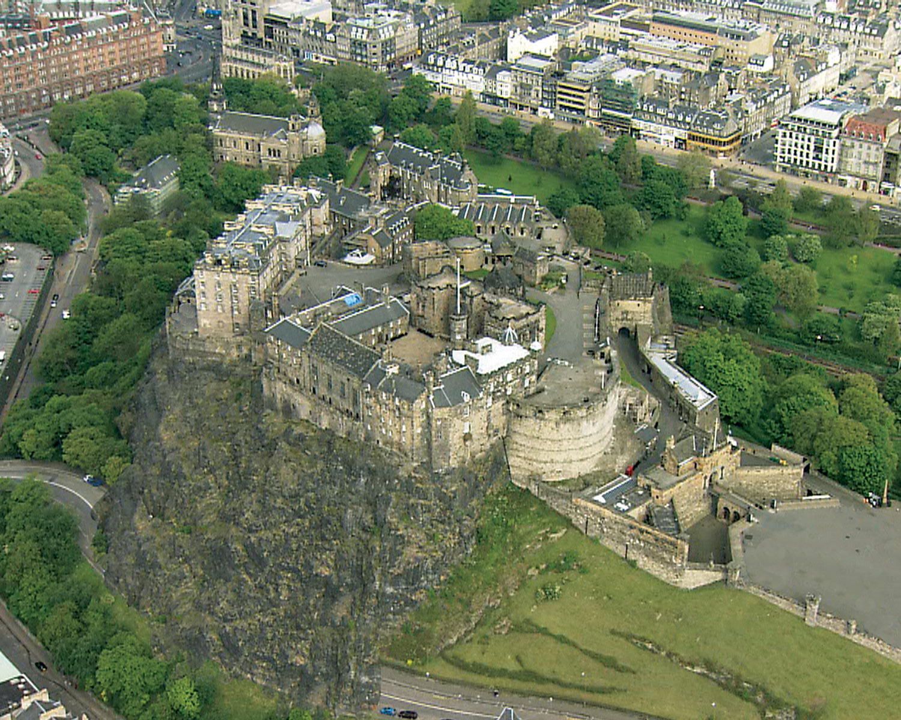
Named Example: Edinburgh Castle

Slide 43
Summary
So far we have…
revised the formation of a
U-shaped Valley (Glacial Troughs),
Hanging Valley
Ribbon Loch
learnt the formation of a Roches Moutonnées
learnt the formation of a Crag & Tail

Slide 44
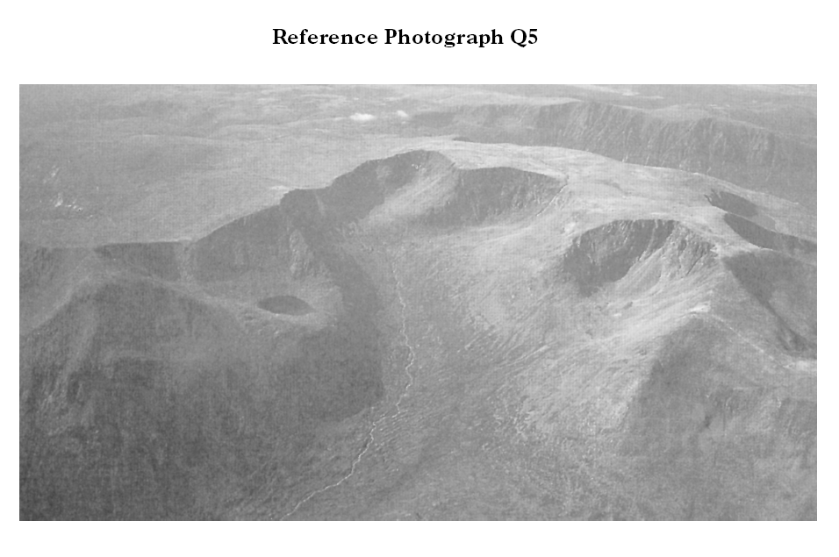
Past Paper Question
Choose one feature of glacial erosion visible in the image. With the aid of a diagram explain its formation. (4 Marks)

Slide 45
Aims of the lesson
To learn about the formation of drumlins.
To learn about the formation of ice marginal moraines:
Terminal
Lateral
Medial
To learn about the formation of erratics.

Slide 46
Landforms of Glacial Deposition
The overall name given to material deposited by a glacier is drift.
Drift can be divided into 2 groups:
Till: Sediments directly deposited by the ice.
Fluvioglacial Deposits: Sediments that are deposited by glacial meltwater.

Slide 47
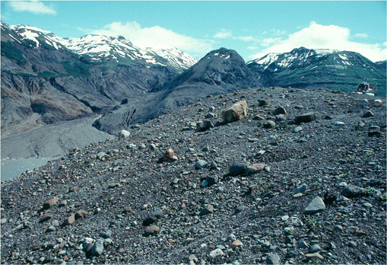
Till Deposits
Till deposited by the glacier results in the formation of two main landforms:
Drumlins
Moraines
Till is unsorted, made up of different sizes and types of rock e.g. boulder clay

Slide 48
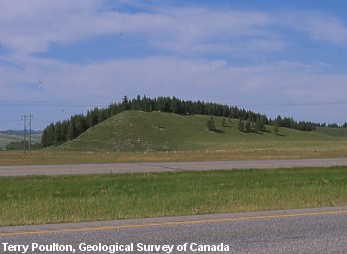
Drumlins
Streamlined hillocks formed of till with a core of rock.
Often found in groups.
Steeper stoss side than lee side.
Indicate direction of ice flow.

Slide 49
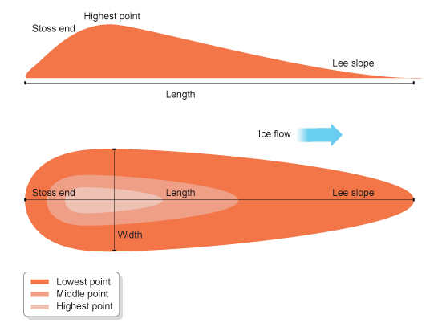
Drumlins

Slide 50
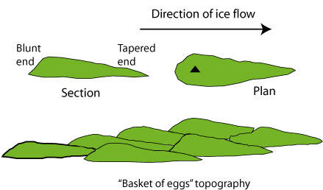

Slide 51
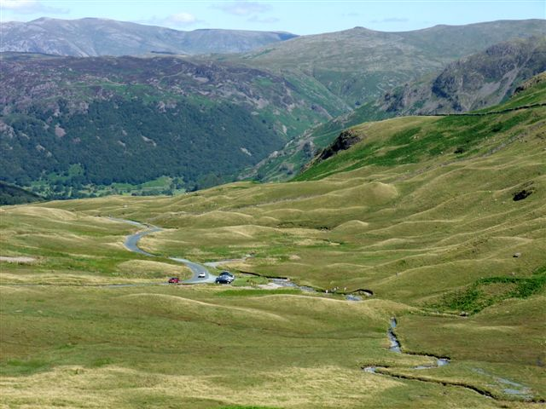

Slide 52
Moraines
These are ridges of till that build up along the margins of a glacier.
They are mainly as a result of:
The dumping of debris from melting ice.
Material being pushed in front of the glacier.

Slide 53
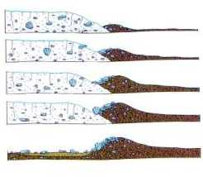
1. Terminal Moraines
Mark maximum extent of the glacial advance.
Mound of till running across the valley at right angles to glacier flow.
After glaciation these ridges hold back lochs.

Slide 54
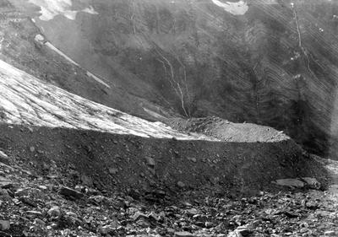

Slide 55
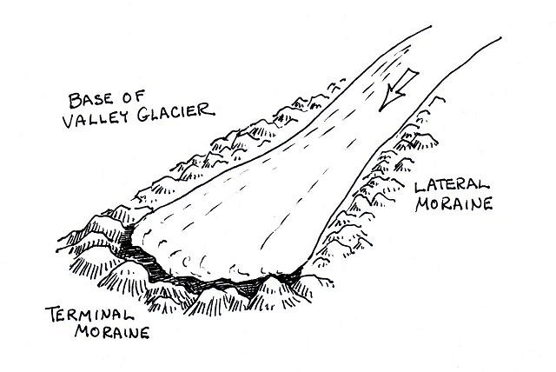
2. Lateral Moraines
Develop on the edge of an advancing glacier.
Form from debris eroded by the advancing ice on the valley sides.

Slide 56
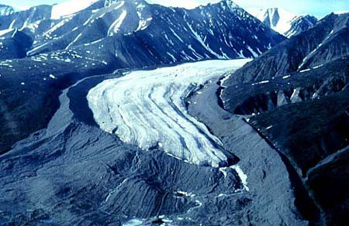

Slide 57
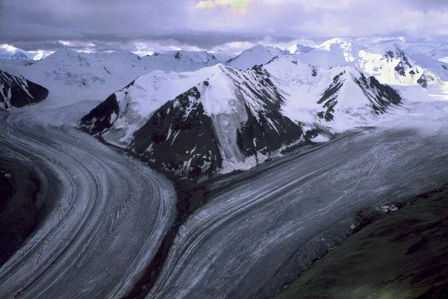
3. Medial Moraines
These form when two glaciers flow together.
The lateral moraines of each glacier merge to form a medial moraine.

Slide 58
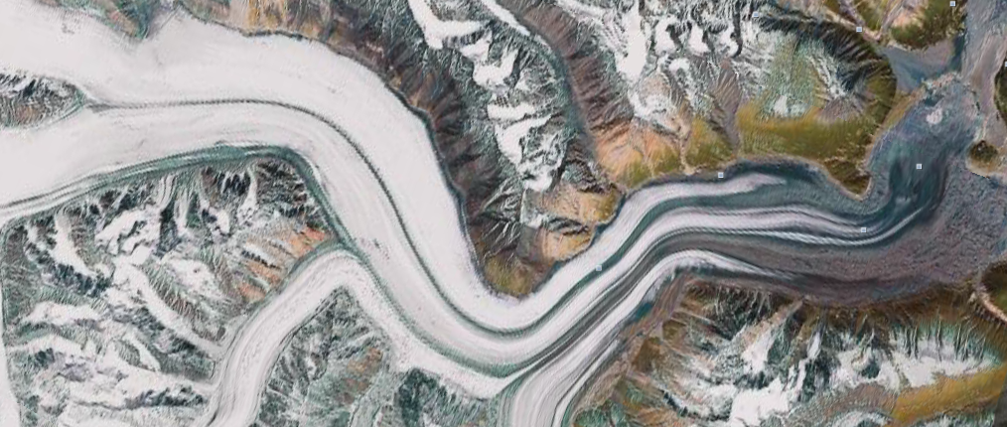

Slide 59
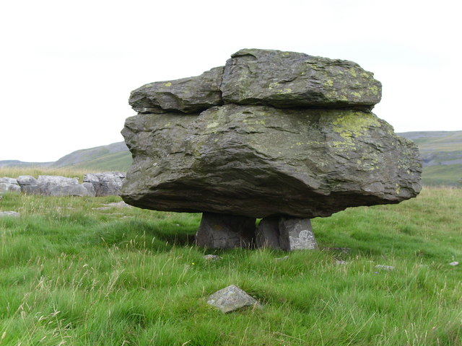
Erratics

Slide 60
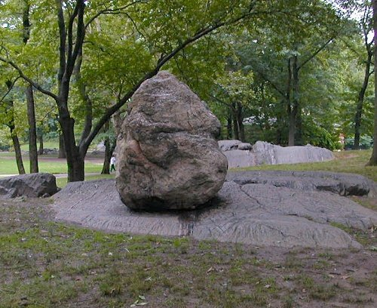
Erratic in New York City

Slide 61
True or False?
The general name given to glacial deposits is till.
The lee slope of a drumlin points in the direction of glacier flow.
Till is described as being a sorted deposit.
Terminal moraines mark the maximum extent of a glacier.
Medial moraines can only form during glaciation.
An erratic does not indicate the direction of glacier flow.

Slide 62
Summary
So far we have…
learnt about the formation of drumlins.
learnt about the formation of ice marginal moraines:
Terminal
Lateral
Medial
learnt about the formation of erratics.

Slide 63
Know your named examples
Named Example
Landform
Gaping Gill
Coire Cas
Glen Avon
Malham Cove
Edinburgh Castle
Grantown on Spey
Ingleborough
U-Shaped Valley
Limestone Pavement
Crag & Tail
Roches Moutonnees
Corrie
Pothole
Stalactites, Stalagmites & Pillars

Slide 64
Aims of the lesson
To learn about the formation of outwash plains.
To learn about the formation of eskers & kames

Slide 65
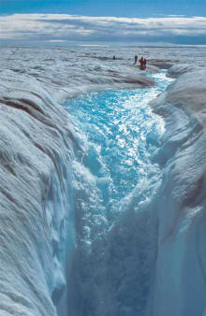
Fluvioglacial Deposits
During deglaciation, vast amounts of meltwater are released often at high velocity.
This deposit is sorted as it is transported by the meltwater.

Slide 66
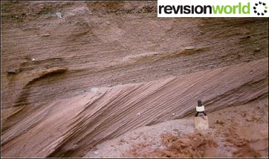

Slide 67
Carousel Activity
On each desk there are some resources describing one of 4 landforms created by fluvioglacial deposits.
Outwash Plains
Eskers
Kames
Kame Terrace
Collect notes on each landform.

Slide 68
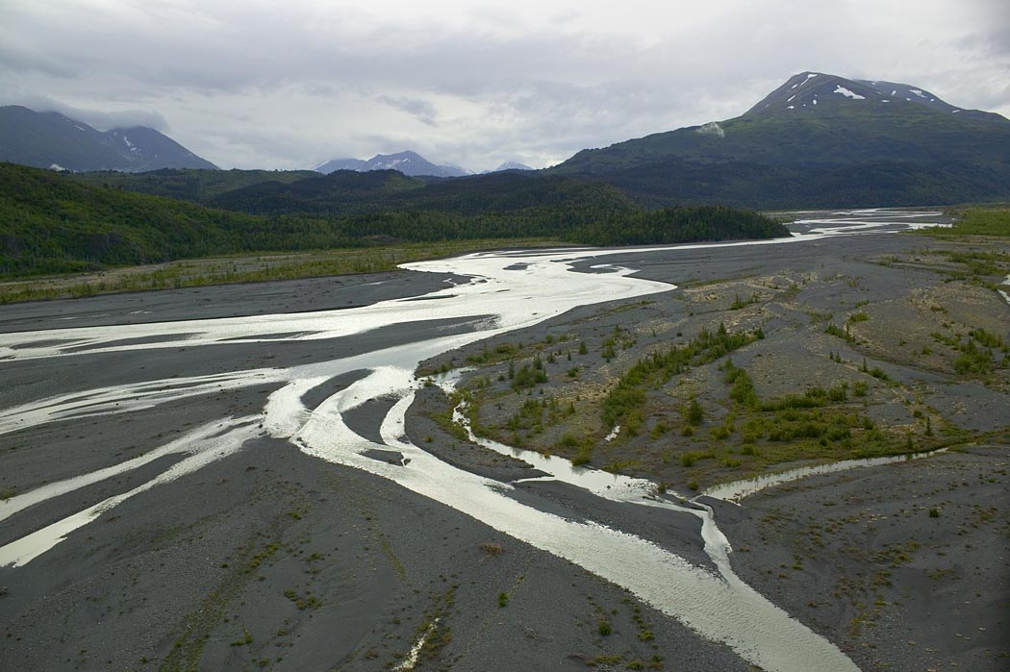
Outwash Plains

Slide 69
Eskers
Glacial streams are found under the ice-sheet.
They are loaded with debris (sand and gravel) carried by the meltwater. As the ice-sheet retreats, the river deposits its load.

Slide 70
Eskers
An esker is a steep-sided, long, winding ridge, made up of gravel and sand.
glacier
river flowing under ice depositing sand and gravel

Slide 71
Kames
Formed close to the ice margin, these are small, mound-shaped hillocks consisting of alternating layers of sand and gravel.
Kames composed mainly of gravel tend to have steeper sides while those formed mainly of sand are gentler and more rounded.

Slide 72
Kame Terraces
These are fluvioglacial benches with level or gently sloping tops.
Often, they were built up by meltwater streams depositing sand and gravel between the ice margin and the ice-free slopes.
Named Example: Dunkeld & Pitlochry

Slide 73
Identify the features shown on the diagram by matching
the numbers to the names given.
Esker; Terminal Moraine; Till (Ground Moraine/Boulder Clay); Outwash Plain; Drumlin; Kettle; Outwash Sands and Gravels.

Slide 74
1 is a Terminal Moraine. A hummocky ridge of unsorted stones, boulders and clays dumped by the glacier at the furthest point it reached
2 is a Drumlin. A long, rounded mound of till, moulded under the flowing ice. Its narrower end points in the direction that the ice was moving. They usually occur in groups (swarms)
3 is a Kettle. A water filled hollow left when a block of ice in the till or outwash melted to leave a hollow
4 is an Esker. A long, winding ridge of sands and gravels left by a stream which ran in an ice tunnel under the melting glacier

Slide 75
5 is Till (Ground Moraine or Boulder Clay). A mixture of broken rocks and clay plastered over the bedrock under the base of the glacier
6 is an Outwash Plain. A nearly flat expanse of sorted sands and gravels washed out of the glacier and carried beyond the terminal moraine
7 is Outwash sands and gravels. The meltwaters washed these away from the glacier, rounding off angular stones and depositing them in layers.

Slide 76
Summary
So far we have…
learnt about the formation of outwash plains.
learnt about the formation of eskers & kames

Slide 77
Aims of the lesson
To learn how to identify glacial landforms on O.S. Maps.

Slide 78
Steep sided hollows formed high up on mountains

Slide 79
If two corries form next to each other, they will leave a sharp ridge between them called a ________________.

Slide 80
If three corries form around a mountain, they cut back and leave a Pyramid in the middle.

Slide 81
Large flat shaped features with steep sides (looking like a letter from the alphabet)

Slide 82
A long thin body of water found in the bottom of a glacial valley.

Slide 83
A glacial feature that hangs above a valley floor, the remainder has been truncated/ chopped off. Often has a waterfall going over the edge.

Slide 84
Corrie
Pyramidal Peak
Hanging Valley
U-Shaped Valley
Arête
Ribbon Lake

Slide 85
Corrie
Pyramidal Peak
Hanging Valley
U-Shaped Valley
Arête
Ribbon Lake

Slide 86
Corrie
Pyramidal Peak
Hanging Valley
U-Shaped Valley
Arête
Ribbon Lake

Slide 87
Higher 2012 Paper 1

Slide 88
Summary
To learn how to identify glacial landforms on O.S. Maps.

Slide 89
Past Paper Question
With the aid of annotated diagrams, explain the processes involved in the formation of a terminal moraine.
(9 marks)
Tips:
Must have a well annotated diagrams (could be before, during and after glaciation),
Refer to your diagrams throughout.

