Slide 1
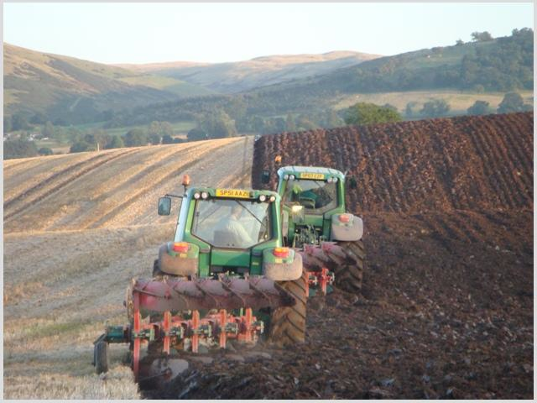
Rural Change Revision
National 4/5: Human Environments

Slide 2
True or False?
Market Gardening produces mainly fruit and vegetables.
The introduction of new technology in farming has not had an impact on the environment.
Genetically modified (GM) crops have had their DNA changed through exposure to chemicals and radiation.
An organic crop has been grown without the use of natural fertilisers.
Diversification is the process by which farm land is given over to a new purpose.
Agribusinesses are small family run farms.
An example of intensive peasant farming is wet rice farming.
The Green Revolution brought new farming techniques to LEDCs, allowing them to produce more food.

Slide 3
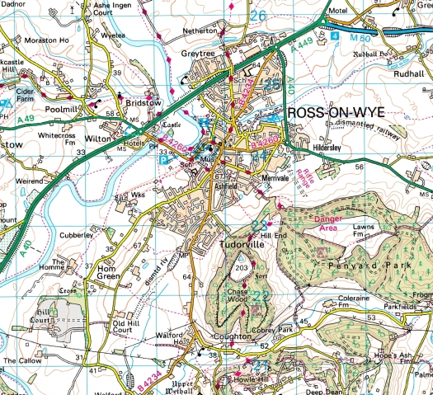
Types of Farming on OS Maps
Study the OS map of Ross on Wye (G2002) carefully.
For each of the types of farming identify an area on the map which would be suitable for each (4 figure grid reference).
On the handout explain why each grid reference is suitable. Use 6 figure grid references.

Slide 4
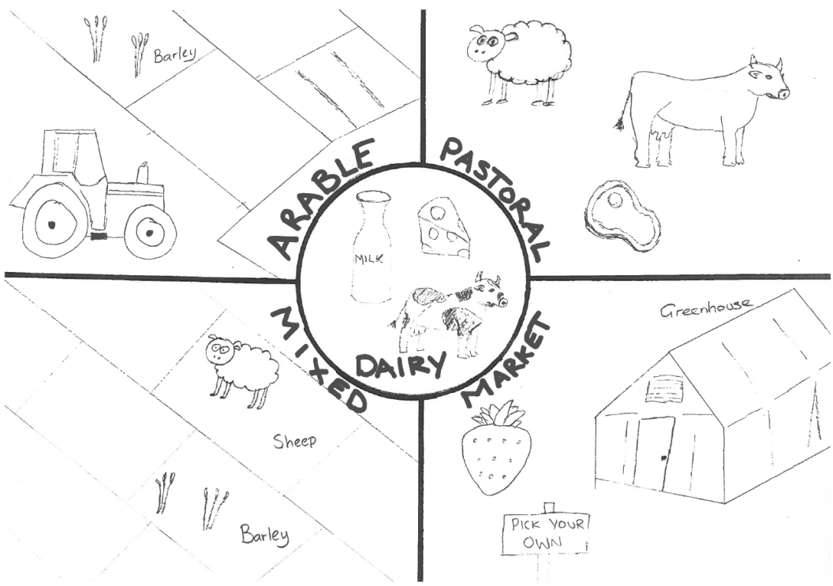

Slide 5
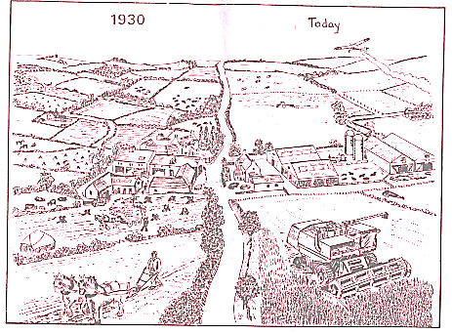

Slide 6
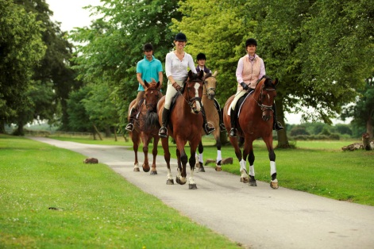
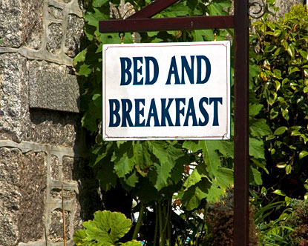
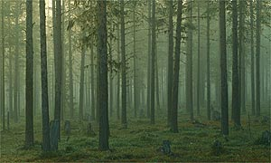
Diversification
On paper, create a spider diagram of different activities a diversified farm could offer to raise more money.

Slide 7
New Technology in Farming

Slide 8
New Technology in Farming
Positive Impacts
Negative Impacts
New technologies like ploughs, combine harvesters and seed drills increase crop yield as work can be done faster.
Producing more crops means that there is an increased profit for the farmer.
Machinery means that there is less physical labour for people.
Fertiliser increases crop yield so they grow better.
Pesticides mean that less of your crop is eaten by pests.
Farms increase in size to make them more suitable for machinery. This leads to a loss of animal habitats.
Increased use of machinery means fewer farming jobs available. People now leave rural areas.
Machines are very expensive to buy. Maintenance is also costly.
Respiratory diseases are common in farm workers due to pesticides used.
Pesticides make their way into nearby rivers leading to pollution (Chemical run-off).
River pollution leads to algae bloom which takes oxygen out of the river.

Slide 9
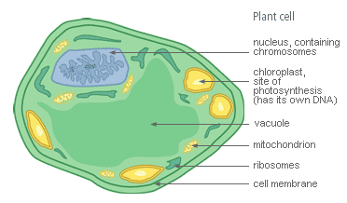
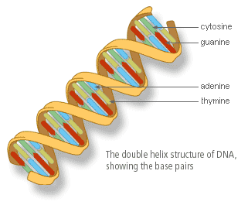
Genetically Modified Crops
This involves scientists changing the DNA of crops by genetic engineering.
The crops are exposed to chemicals and radiation.

Slide 10
Positive Aspects | Negative Aspects
GM crops can be made more resistant to pests like insects. This means less harmful pesticides need to be used. | Many argue that GM crops do not taste as good as unaltered crops.
GM crops grow faster meaning farmers can produce more food and make a greater profit. | Altering crops may make them poisonous to other organisms that rely on them for food e.g. Monarch Butterfly.
Scientific research suggests that GM crops contain more nutrients making them better to eat. | Pest species may evolve to tackle GM crops. These pests will be stronger and more dangerous to our food supply.
Increased food production reduces risk of world starvation. | There is a possibility that eating GM crops may have harmful effects to human health.

Slide 11
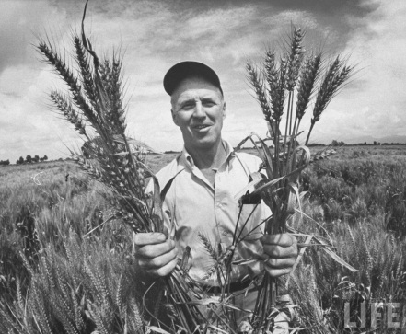
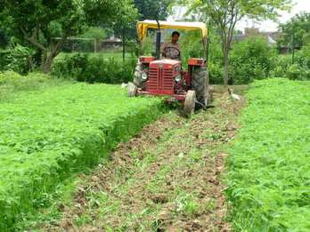
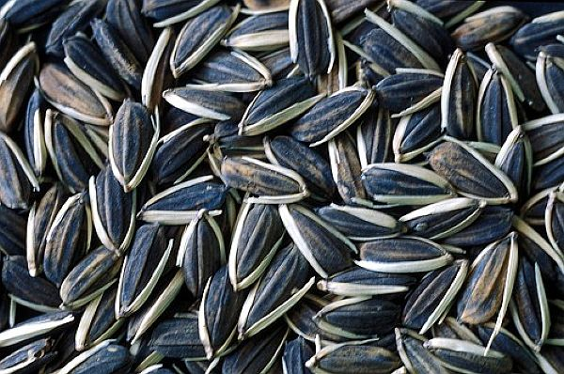
The Green Revolution
New farming ideas, seeds and equipment introduced to LEDCs e.g. India
High Yield Varieties (HYVs)
Seeds resistant to pests.
Faster growing.

Slide 12
The Green Revolution
Advantages
Disadvantages
Crop yield doubled
India self sufficient.
Wider diet available.
Bigger harvest = more money.
New fertiliser industry = jobs.
Increased costs.
Fertilisers can reduce yields if farmers not fully educated.
Mechanisation = unemployment.
Environmental damage.
Health problems.

