Slide 1
Urban Change
Higher Geography

Slide 2
Human Unit Outcomes
1 Use a range of research skills and techniques in human environment contexts by:
1.1 Identifying suitable sources of geographical information
1.2 Collecting geographical information using at least two gathering techniques, including fieldwork where possible
1.3 Processing geographical information using a range of techniques
1.4 Analysing geographical information
2 Draw on and apply knowledge and understanding of the processes and interactions at work within human environments by:
2.1 Giving detailed descriptions and detailed explanations of a process/interaction at work within urban environments in a developed and a developing country
2.2 Giving detailed descriptions and detailed explanations of a process/interaction at work within rural environments in a developed and a developing country
2.3 Giving detailed descriptions and detailed explanations of a complex issue relating to human environments in a developed and a developing country

Slide 3
Unit Learning Intentions
2.1 Giving detailed descriptions and detailed explanations of a process/interaction at work within urban environments in a developed and a developing country

Slide 4
Human Unit
In this Unit, you will develop and apply geographical skills and techniques in the context of human environments.
You will develop research skills in geographical contexts.
You will develop and apply knowledge and understanding of the processes and interactions at work within urban and rural environments in developed and developing countries.
Key topics include: population, rural land degradation and management, urban change and management. Personalisation and choice is possible through contexts chosen as case studies.

Slide 5
Outcome 1
Identify at least two suitable sources of geographical information.
Collect relevant geographical information on the topic using at least two gathering techniques.
Process the information collected using at least two geographical techniques.
Analyse at least two key aspects of the geographical information.
Describe and explain the process of managing an urban issue in a developed and developing country.
Explain a process/interaction at work within rural environments in a developed and developing country.
Explain a complex issue relating to human environments in a developed and developing country.

Slide 6
http://www.gatm.org.uk/?p=95

Slide 7
WE WILL
Be able to name and describe different urban models.
Consider how such models apply to Edinburgh.

Slide 8
Urban Models
Geographers have put together models of land use to show how a 'typical' city is laid out

Slide 9
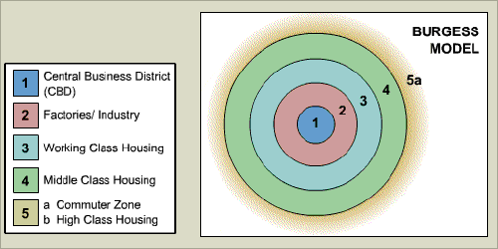
Concentric Model – Burgess
Land values are highest in the centre of a town or city. This is because competition is high in the central parts of the settlement. This leads to high-rise, high-density buildings being found near the Central Business District (CBD), with low-density, sparse developments on the edge of the town or city.

Slide 10
Sector Model - Hoyt
Based on the circles on the Burgess model, but adds sectors of similar land uses concentrated in parts of the city.
Some zones, eg the factories/industry zone, radiate out from the CBD. This is probably following the line of a main road or a railway.

Slide 11
Multiple Nuclei (Ullman and Harris
Based on the fact that many towns and nearly all large cities grow about many nuclei rather than around a simple CBD. Distinctive land-use zones develop because some activities repel each other; high-quality housing does not generally arise next to industrial areas, and other activities cannot afford the high costs of the most desirable locations.
New industrial areas develop in suburban locations since they require easy access, and outlying business districts may develop for the same reason

Slide 12
Mann’s Model
Combines the sector theory with the concentric zone model. Four basic sectors are postulated: middle class, lower middle class, working class, and lower working class.
Each sector displays four zones. In each case, there is the CBD, the transitional zone, a zone of smaller houses, and the outermost zone made up of post-1918 housing.

Slide 13
Activity
Read page 327 of textbook.
Complete sheet to show how the models apply to Edinburgh.

Slide 14
Model | Description of Model | Edinburgh
Concentric Model (Burgess)
Sector Model (Hoyt)
Multiple Nuclei (Ullman and Harris)
Mann’s Model

Slide 15
WE WILL
Describe and account for the likely land uses to be observed in the CBD
describe and explain the changes which have taken place in the CBD and the old inner-city area
explain why changes were necessary and comment on their success

Slide 16
As most maps show, the main roads converge on this area. You would refer to this and identify roads by name if possible.
You would also look for buildings such as train and bus stations, town halls, museums, information centres, perhaps colleges and other large further education establishments, large churches, possibly even cathedrals, large blocks of buildings which could be shopping centres, car parks and possibly theatres.
It is unlikely that there would be much evidence of industry, either in estates or large works.

Slide 17
There would also be little evidence of housing. However the street patterns may show small narrow streets at the very centre indicating the oldest part of the settlement. Whenever these features are identified, grid references of their location should bee given to support identification.
The CBD may also be identified in terms of its location in that most would be found in the most point of the city and certainly the part of city which is most accessible.
There may be some streets which have shapes such as, small cul-de sacs and curves. These streets may contain large terraced houses which have been converted to offices.
This has happened in, for example, Edinburgh and Glasgow.

Slide 18
The Core Area - CBD
The site of this area is often but not always in the centre of the settlement and it should be the most accessible point, indicated by the convergence of all major transport routes, both road and rail.
Due to this highly accessible position, it is the area where most services would like to locate so as to gain maximum access to their customers.
Functions such as retailing, wholesaling, offices, services, public administration, entertainment transport terminals, art centres are all located here.
This is also the area where land prices are most expensive and only those functions which can afford the relatively high cost of this land can compete for space

Slide 19
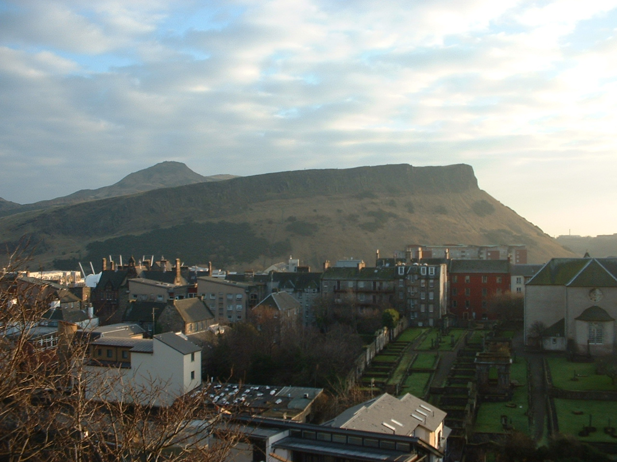
Edinburgh’s CBD
The old town & the new town.
Includes the Royal Mile, Princes Street, Queen Street, as far as Holyrood Palace.

Slide 20
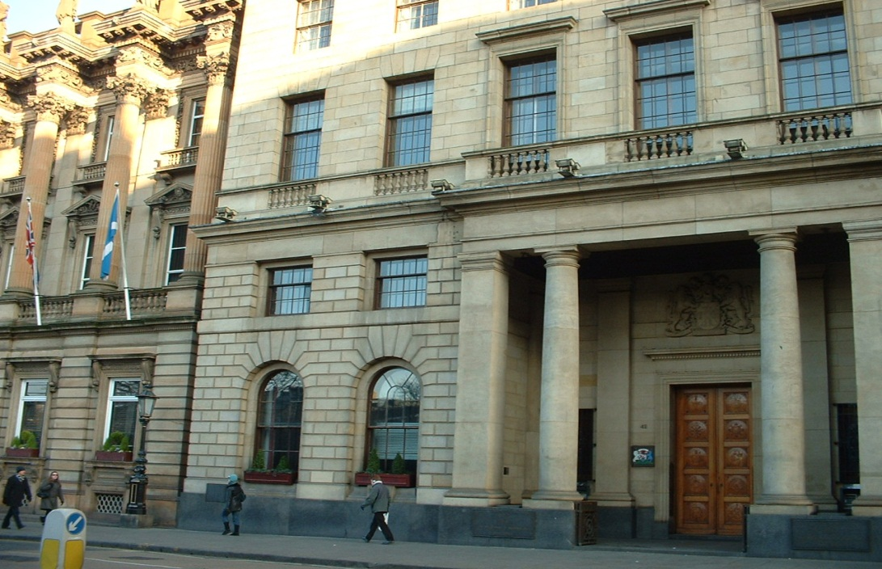
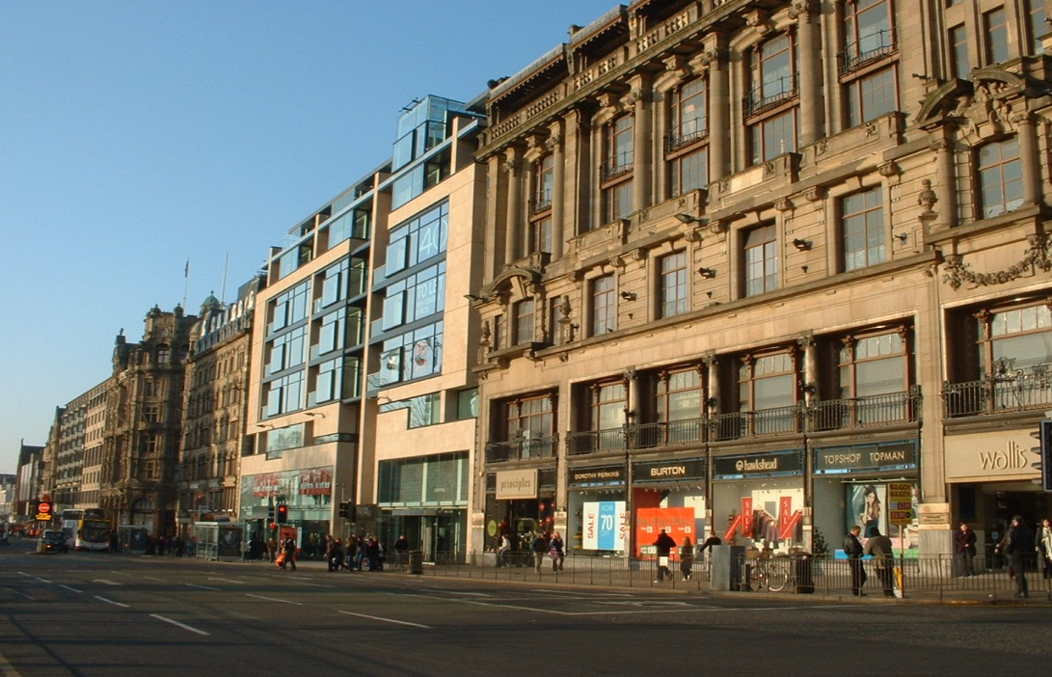
Taller buildings
Lack of open space
Most expensive land
Route centre (roads and rail)
Competition for land
Most accessible spot
Central in city

Slide 21
Edinburgh’s CBD
Shops ...large chain stores
e.g John Lewis, M&S on Princes St.
Shopping Centres
Princes Mall,St.James’s centre.
Large Banks, insurance companies
e.g Standard Life
Tourism
e.g Castle, Holyrood Palace, museums, Dynamic Earth
Government offices
e.g Parliament.
Bus stations
St.Andrews Square
Main railway station
Waverley
Recreation...
Pubs e.g. Rose St.
Theatres e.g Playhouse
on Leith Walk
cinemas,
hotels (The Balmoral)
eating places.
Exclusive stores
e.g.Harvey Nics, Multrees Walk

Slide 22
Activity
Compare old/new maps and photographs and consider the changes.
Design project for Inverness CBD

Slide 23
Problems in Edinburgh’s CBD
Traffic congestion
High rent / land values
Lack of land for expansion
Lack of car parking
Cost of maintaining old buildings
Customers wanting indoor shopping

Slide 24
Changes in the CBD
Large expensive stores built e.g Harvey Nics.
New cinema / eating complex built
Omni-centre
Plans for underground car parks & improved shops in Princes Street.
Many houses (George St, Queen St.) converted to offices)
Movement of many offices out of city
Attempts to attract customers at Christmas with fair / ice rink / market

Slide 25
Changes in the CBD cont…
Bank buildings converted to pubs, restaurants etc.
Movement of bank HQ:
RBS to Hermiston Gait and HBOS to Gyle.
The Gyle shopping centre built, attracting shops & customers.
Covered shopping centres
Princes mall and St James centre
Scottish Office moved to Leith.

Slide 26
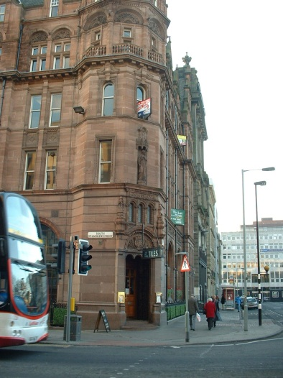
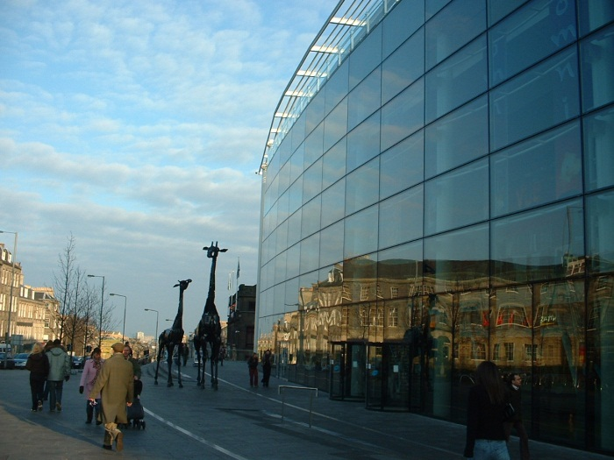
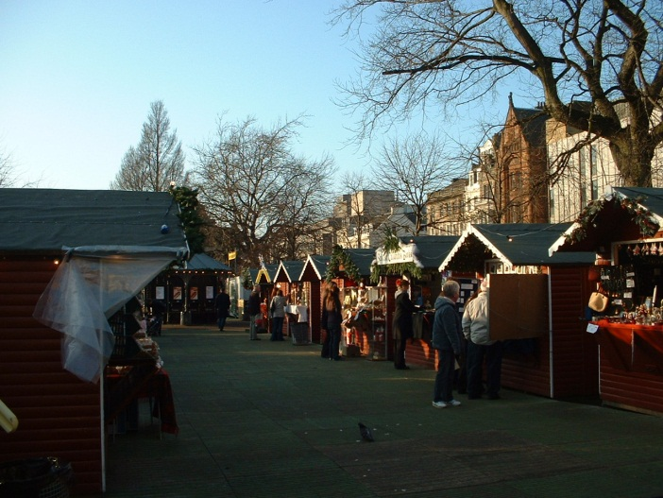
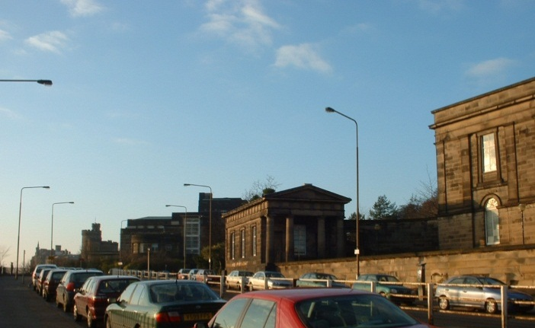
Converted
bank
New cinema
complex
German Market
Former Scottish Offfice

Slide 27
Exam Question
“The Central Business District of major cities undergoes continuing change.”
Referring to a city that you have studied in the Developed World, explain the changes which have taken place in the CBD over the past few decades.
You should refer to named locations within the CBD
(5)
TIP: Give real examples, explain the changes using linking words like ‘due to’, ‘so that’, ‘so’, ‘because of’, ‘therefore’, ‘in order to’.

Slide 28
Transport
Regeneration Projects
Movement
Changes in the CBD
(Edinburgh)
Employment
Leisure
Commercialisation
Markets
Developing Shopping centres in and around Edinburgh

Slide 29
They now have a Tram Line.
They did this to lower traffic congestion.
To get out of the busy CBD
More space to expand
Cheaper land
Transport
Regeneration Projects
Movement
Change appearance of CBD
Movement of Bank HQ: RBS to Hermiston Gait & HBOS tp Gyle
Changes in the CBD
(Edinburgh)
New stores moving to Edinburgh CBD
German market
Commercialisation
Markets
Developing Shopping centres in and around Edinburgh
Attract people into the CBD
New Stores
Gyle Shopping Centre
Brings out people from Edinburgh city centre and takes them out to shopping centres outside Edinburgh itself.
Harvey Nics
Banks, tertiary industries relocating to estates which allows more shops restaurants to open.

Slide 30
Comparison of CBDS
Location within the settlement.
Accessibility with reference to roads, railways bus and train stations.
The general size of the areas.
Types of zones close by e.g. industry or housing.
Perhaps comment on the presence of individual such as tourist information centres, churches. Etc.

Slide 31
Exam Style Question
Describe and explain the changes, other than shopping, which have taken place in the CBD over the past few decades.
5

Slide 32
Answer
pedestrianisation and landscaping of CBD roads eg Buchanan Street, Argyle Street etc to reduce traffic flow in and around the CBD – to increase pedestrian safety and improve air quality and environment.
Upgrading of CBD open space, eg George Square.
diversification of city employment – much greater emphasis on tourist industry (significance of city-break holidays) leading to increased bed accommodation in new CBD hotels (Hilton, Radisson). Hotels can also tap into lucrative conference market given Glasgow’s improved image as a tourist and cultural centre.
alteration of CBD road network – one-way streets (around George Square), bus lanes to discourage use of private transport and encourage use of public transport. Also achieved by increased metering and increased parking charges in and around CBD.
renovation and redevelopment of many CBD sites to provide modern hi-tech office space (Lloyd’s TSB, Direct Line etc) and residential apartments (Fusion Development, Robertson Street).
building of M8, M77 and M74 extension all designed to keep through traffic off CBD roads.
younger, more affluent population continues to be attracted to central city area by long-standing concentration of up-market pubs, clubs, cinemas etc (Cineworld in Renfrew Street).
contraction of number of public transport termini within CBD (2 major railway stations instead of 4) but upgrading of remaining termini, (Buchanan Street bus station, Central Station).

Slide 33
WE WILL
Consider traffic problems and the measures taken to reduce such problems.

Slide 34
What traffic problems might Edinburgh face?
What could be done to reduce such problems?

Slide 35
Use of roundabouts to improve flow.
Ring road around city centre.
Park and ride schemes.
Pedestrianised areas in the centre.
Strategies to tackle transport problems
Parking restrictions and fines.
One way systems.
Multi-storey car parks.
Bus lanes/improved public transport

Slide 36
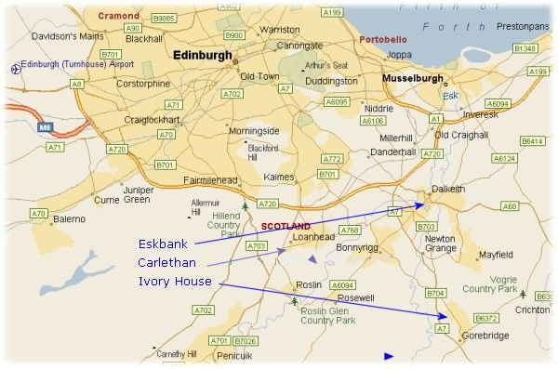
Edinburgh City Bypass
A720 Edinburgh City Bypass Trunk Road

Slide 37
A720 road, 21 km A1 towards north-east England, the A702 towards north-west England
Prevent unnecessary traffic entering the city centre.
Use of roundabouts to improve flow.
Ring road/bypass around city centre.
Park and ride schemes.
Proposed increased pedestrian areas for Princes Street and George Street. George Street shut to vehicles during Festival for street cafes.
Pedestrianised areas in the centre.
Strategies to tackle
transport problems
Less traffic. Pedestrians feel safer.
Parking restrictions and fines.
One way systems.
Multi-storey car parks.
Bus lanes/improved public transport
Helps improve traffic flow and allows
Plans for George Street

Slide 38
Pedestrianised areas in the centre. | Proposed increased pedestrian areas for Princes Street and George Street. George Street shut to vehicles during Festival for street cafes.
Bypass/Ring road around city centre. | A720 road, 21 km A1 towards north-east England, the A702 towards north-west England, the M8 through the Central Belt towards Glasgow, the A7 through south-east Scotland and north-west England as well as the A8 leading to the M9 for Stirling and the Forth Road Bridge. The road is dual carriageway standard throughout
Park and ride schemes. | Hermiston Park and Ride Ingliston Park and Ride Free parking bus every 5 minutes to Edinburgh city centre at peak times. CCTV protected.
Parking restrictions and fines. | George Street in the ‘New Town’ permit parking. Edinburgh is spilt into two zones. The original zone around the city centre is called the Centre Controlled Parking Zone (CPZ). Parking is allowed from 8.30 to 18.30, Mon to Sat. Tickets must be purchased. Outside area is called Peripheral Parking Zone. Parking form 8.30 to 17.30, Mon to Sat. CPZ is used to reduce long term parking. Can now pay for parking on the phone. In 2008 the collected £7 million in parking fines. Around £11 per head.
Multi-storey car parks. | To the North East of Princes Street there is St James on Elder Street open 24 hours and has 254 spaces St James on Leith Street open 24 hours and has 280 spaces To the East of Princes Street there is Calton Street open Mon-Fri (7:30am to 7:30pm) and Sat (10pm to 5pm) and has 40 spaces Waverly behind Waverly Station closes at midnight and has 350 spaces Edinburgh St James Centre – Leith Walk £19 a day Waverly Station (short stay) – Free Waverly Station (long stay) - £18
Bus lanes/improved public transport | A8 – Glasgow road – Maybury to Princes Street, A900 – Leith walk – Leith to Princes Street, A702 – Lothian road – Leven Street to Hayemarket, A70 – Slateford road – Inglis Green to Hayemarket, A71 – Calder road – City bypass to Ardmillan.
improved public transport | trams
One way systems. | Plans for George Street

Slide 39
Exam Style Question
“Traffic congestion is now a major problem facing many cities in EMDCs”.
Describe and explain schemes which have been introduced to reduce problems of traffic management in any named city you have studied in an EMDC.

Slide 40
Exam Style Question
For a developed city you have studied explain the management of transport.
5
For a city in the developing world explain the management of transport.
5

Slide 41
Transport Research
Research transport developments in Edinburgh and Mumbai.
To do this you will have to:
Identify at least two suitable sources of geographical information.
Collect relevant geographical information on transport in Edinburgh and Mumbai using at least two gathering techniques.
Process the information you have collected using at least two geographical techniques.
Analyse the geographical information to clearly show at least two differences in transport development in Edinburgh and Mumbai.
Example
I have chosen to use an article from the BBC news website about a new traffic management system in Mumbai as it is a reliable and accepted source of news. I have also chosen to do fieldwork by visiting the park-and-ride at Inverkeithing to see how successful it is in easing congestion into the city from the North. (AS 1.1)
In meeting AS 1.2 and 1.3, you could create a table/pie chart of a transport survey showing, for example, the variety and number of vehicles in a given period.
The other data form could be a table, with information taken from the website, showing the variety of transport options in Mumbai — cars, rickshaws, bullock/ox carts, buses, taxis, bikes, lorries.

Slide 42
Sample Response
Mumbai and Edinburgh have adopted different approaches to transport developments.
Edinburgh has a planned transport infrastructure including park-and-ride facilities, bus lanes and bike lanes. The city has spent a great deal of time and money developing a tram system. This is part of an overall strategy to cut traffic congestion in the city and make moving about the city more efficient.
Mumbai has also attempted to plan for traffic management. It does have a very new traffic-light management system to control traffic jams but traffic problems persist. Although 90% of commuters travel by public transport, it is very crowded and there is a growth of car users in the middle class who have the money to pay for a car so moving about the city is becoming more difficult.

Slide 43
Leith

Slide 44
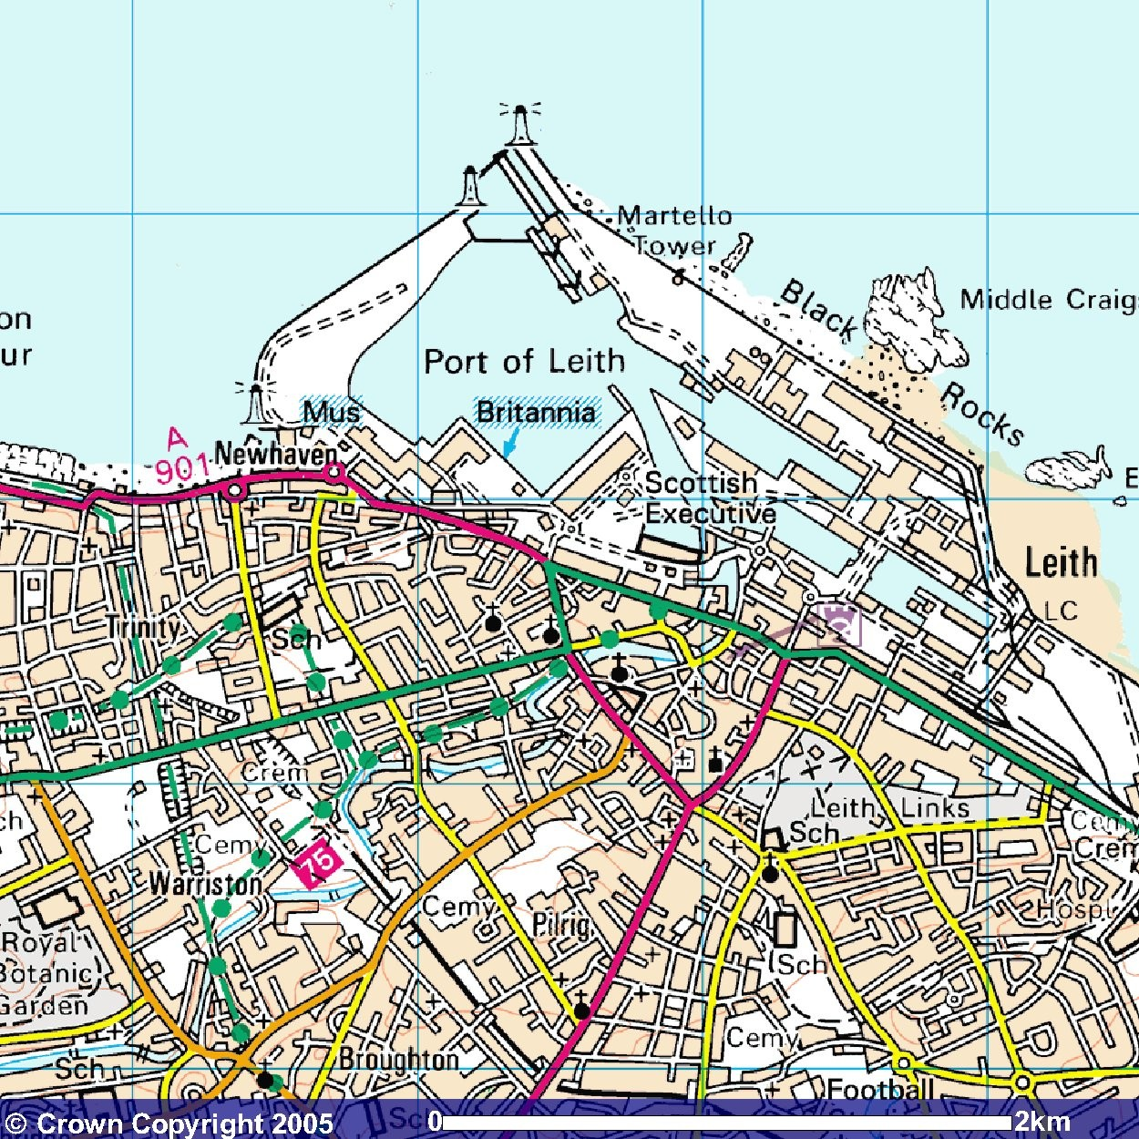
The Inner City: Leith

Slide 45
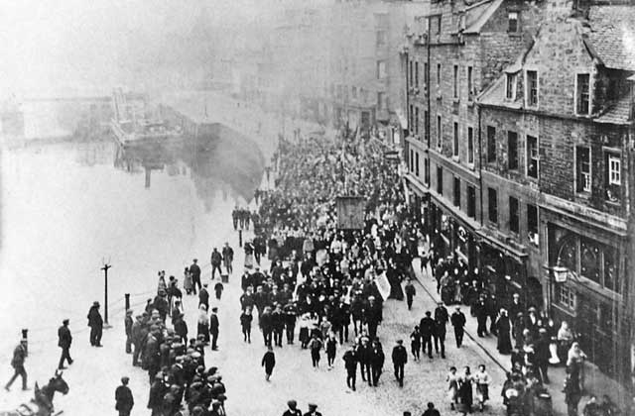
Historical Leith
Leith used to be a busy port
Trade with UK and rest of Europe
Whisky and sugar warehouses
Fertilisers
Lots of people employed there
Many goods transported by railways and canals
Shipbuilding
Pre-Change Leith
Port trade declined
Loss of many industries
e.g shipbuilding; fertilisers; distilling.
Lots of derelict land + derelict buildings.
Many substandard houses.
Many empty buldings.
Limited shopping facilities.
A declining, and ageing population.
1960s tower blocks

Slide 46
Housing Tenements
Tenements were commonly built in many countries and particularly in cities such as Glasgow and Edinburgh. They are buildings designed for multi-occupancy and usually found in the inner city area.
Tenements were originally associated with providing accommodation for the less affluent and were located near factories for workers.

Slide 47
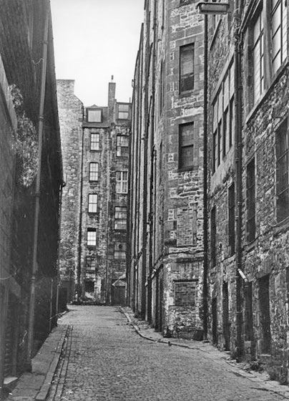
Niddry Street South, Edinburgh
Typical features of Tenement Housing
Slate Roofs
Chimneys
Built from Stone
Several storeys
High density
High level of pollution
No parking/garages
Little open space

Slide 48
Issues in Inner City Areas
High density of buildings and lack of good quality open space eg. Parks
Older, nineteenth century, lower-cost housing - likely to be tenements in Scotland and terraced housing in England - The houses had been built quickly alongside the industries to provide homes for the workers.
Slum housing
Derelict land
Old declining industry
Declining population with high unemployment
Large areas of re-development or urban regeneration
Limited convenience shopping facilities
High levels of air pollution from traffic, and visual pollution in the form of vandalism and graffiti
Areas demolished and used for motorways and ring roads

Slide 49
Solutions
New housing, such as high rise flats
Renovation of older housing, often tenements
Environmental improvements by landscaping, improving docklands
Attracting a mix of inhabitants for example, by introducing luxury flats
Increased employment opportunities by opening restaurants, leisure centres and government offices such as the Scottish Office
Upgrading shopping areas and improving road links

Slide 50
Buildings are being sand-blasted, rewired and replumbed
Many are having windows renewed & fire resistant doors installed.
In an effort to cut down on vandalism, many flats now have an entry phone system.
Old warehouses and big old houses(too costly to run as family homes)have been turned into offices or divided into flats.

Slide 51
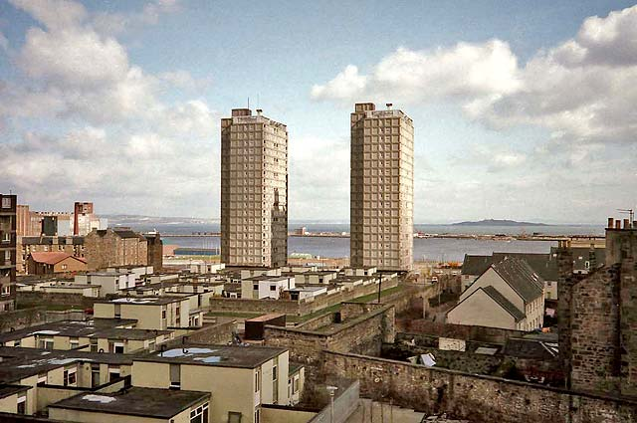
Cairngorm House and Grampian House - 1987
These flats were demolished in 1997

Slide 52
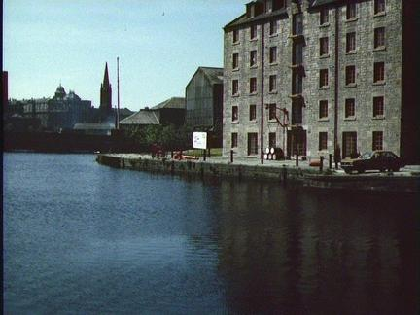
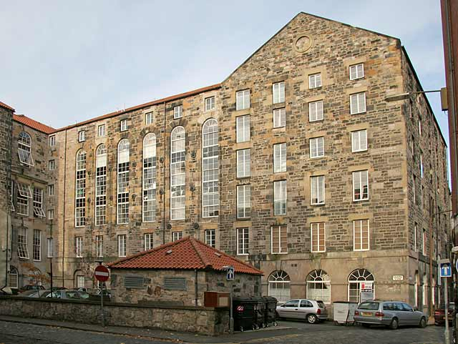
warehouse at the Docks, which has been redeveloped for housing
This large old flour mill in Leith was built in 1828. It has now been converted into apartments.
In 2002, Cuckfield developers converted this old whisky bond to 104 apartments.
They also converted the 9-storey sugar bond beside it to offices and built a new 6-storey office block named Anderson House on the same site.
Carpet Lane
Apartments

Slide 53
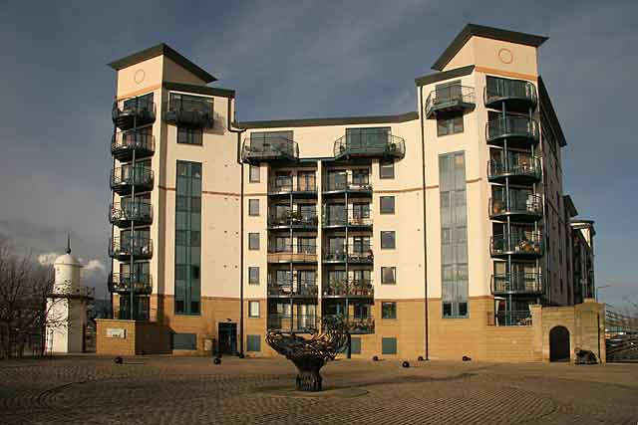
Modern Apartments
Tower Place

Slide 54
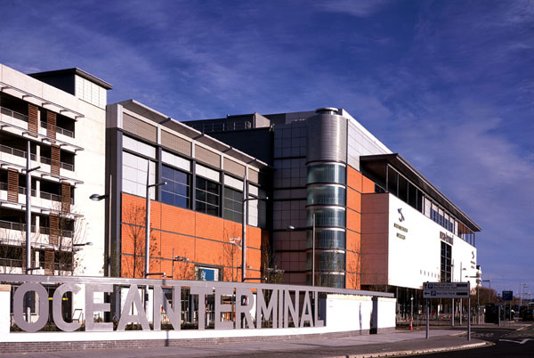
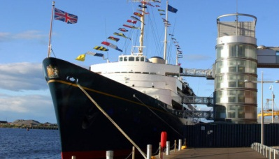
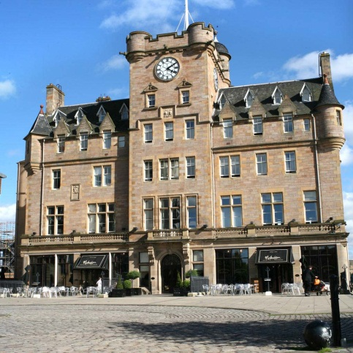
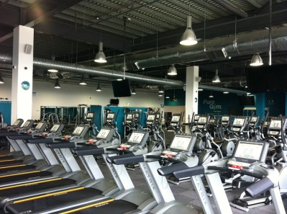
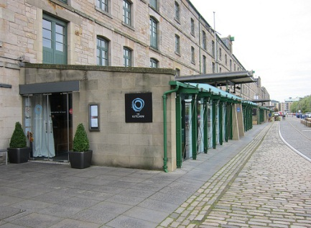
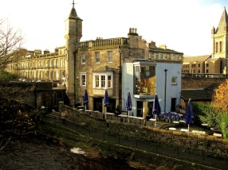
Recent Development in Leith
Real radio station.
The Ocean Terminal shopping centre.
Royal Yacht Britannia.
New hotels (Malmaison)
Health Club (Pure Gym in Ocean Terminal)
Large restaurants (The Kitchin)

Slide 55
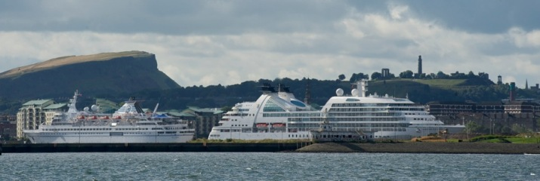
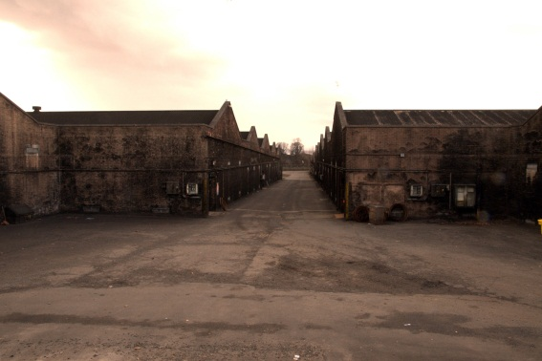
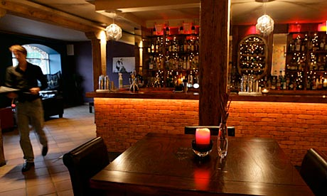
Big events e.g Tall Ships and MTV awards.
Development of passenger shipping trade.
‘Gentrification’ of old Whisky Bonds.
Leith Walk – tree planting.
Large stores

Slide 56
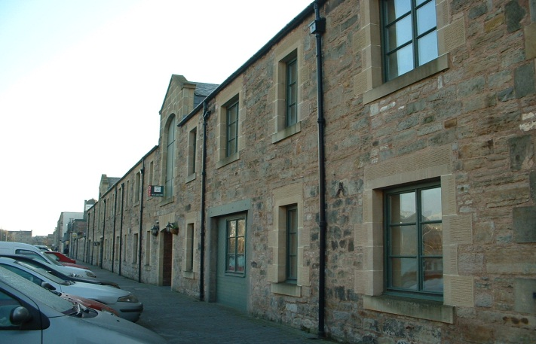
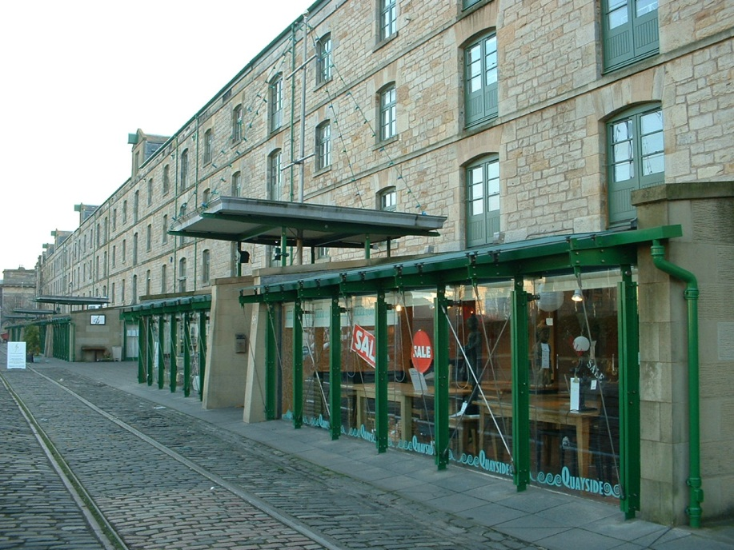
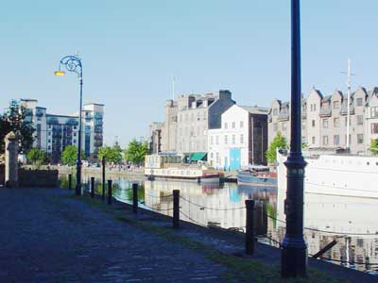
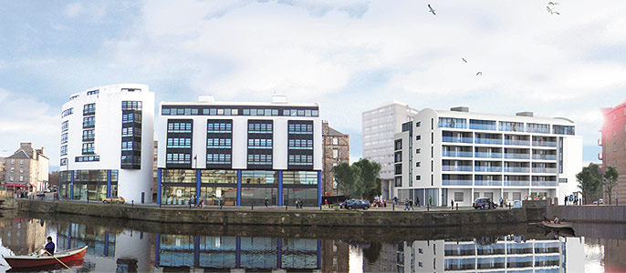
Converted warehouses: shops, bars, restaurants on ground floor, flats above.
Recent Develoments in Leith

Slide 57
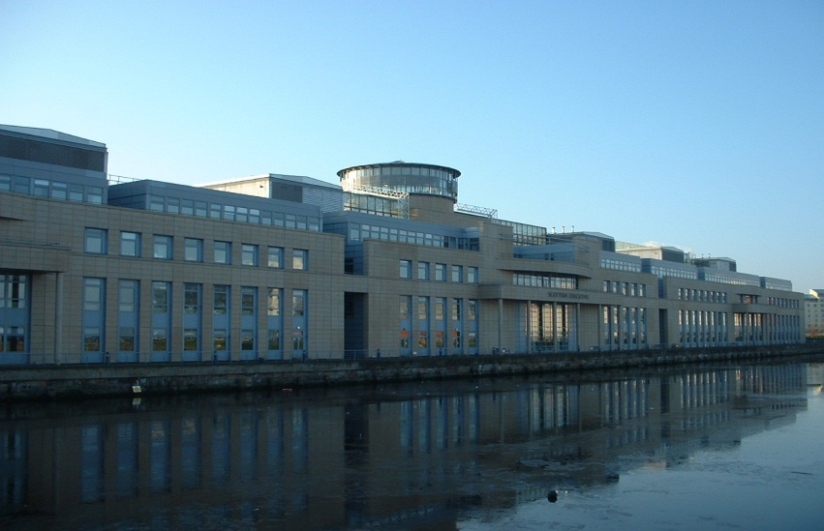
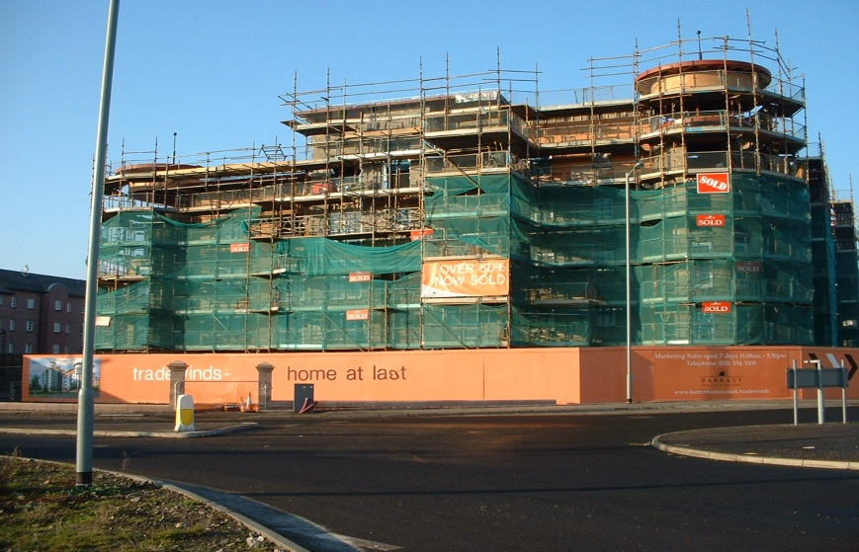
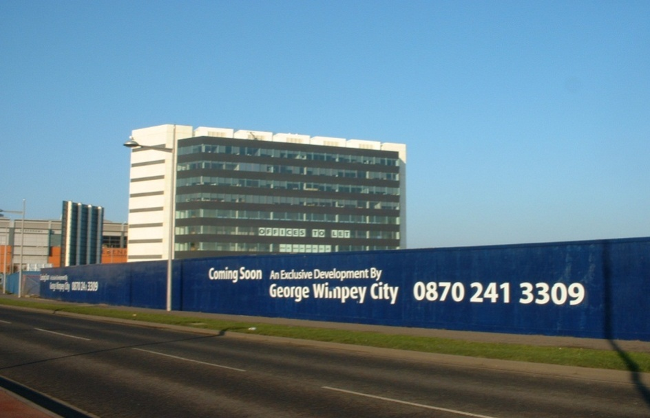
Scottish Executive
Headquarters
(Victoria Quay)
New Expensive Flats

Slide 58
Exam Style Question
Referring to an inner city landscape in Glasgow, or in a city you have studied, describe and explain the changes which have taken place in recent years.
6
Assess the effectiveness of solutions to tackle problems in the inner city (focusing on housing) for a city you have studied.
6

Slide 59
WE WILL
Be able to describe the problems of shanty towns/slums.
Focus on one case study of a slum
Consider the effectiveness of solutions used to tackle the problems.

Slide 60
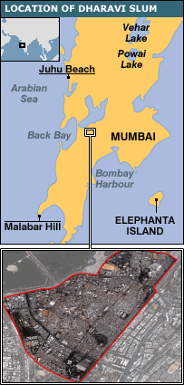
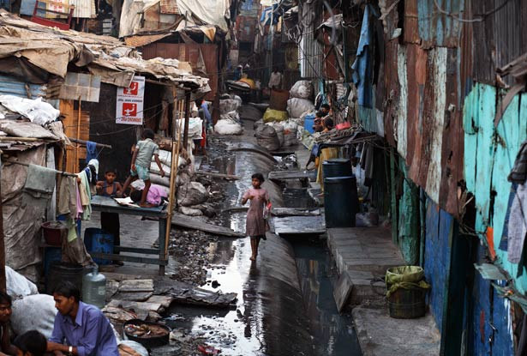
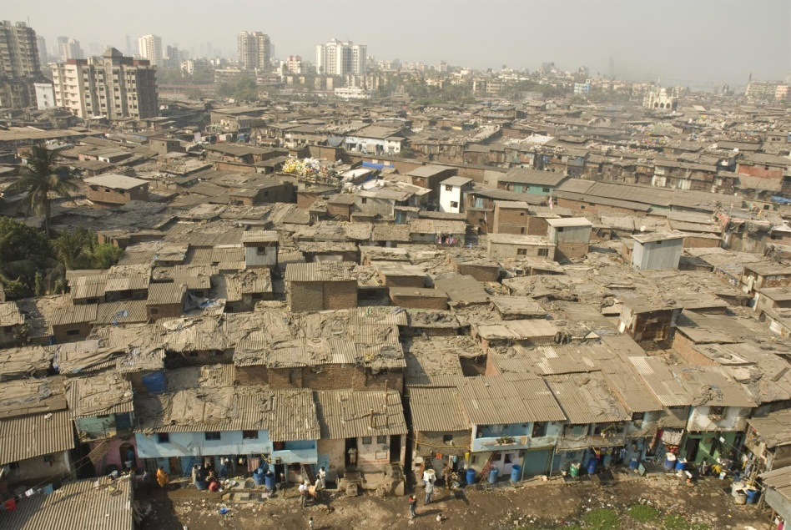
Shanty Towns
Dharavi - Asia's largest slum
Mumbai
Population – estimates between 600,00 to 1 million

Slide 61
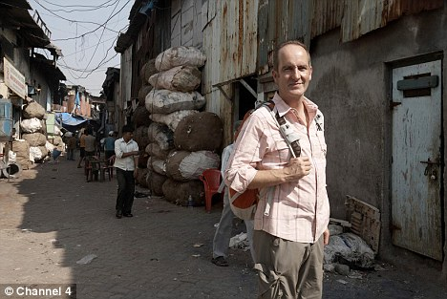
Kevin McCloud – Slumming It Ch 4 documentary 2010
Slumming it part 1
Slumming it part 2

Slide 62
BBC info
National Geographic article

Slide 63
Problems
Overcrowding - population of more than 600,000 people
noise, water and air pollution
Lack of sanitation
Next to the open sewers are water pipes, which can crack and take in sewage.
Disease - doctors deal with 4,000 cases a day of diphtheria and typhoid
no legal rights to the land.
no maps or road signs

Slide 64
Collapsing Infrastructure
Many cities in the developing world do not have an infrastructure that is capable of dealing with the massive increases in population.
In addition, the governments do not have sufficient funds available to maintain the facilities, let alone improve them.

Slide 65
Increasing levels of pollution
Pollution of air, land and water is a major problem in most developing world cities. The drive to industrialisation brings with it inevitable problems, especially as legislation to protect the environment is often non-existent or rarely enforced. Furthermore, the hidden economy can add to the levels of pollution as small, unlicensed industries are set up in peoples homes or on rooftops. These industries release their pollutants into the air, land and water.

Slide 66
Increased volume of traffic on poorly maintained roads.
The water supply can also become polluted as inadequate sewerage facilities allow the spread of harmful bacteria. Indeed, death from water-borne disease is one of the biggest causes of high infant mortality rates.

Slide 67
Inadequate housing and services.
Shanty towns display most problems typical of developing world cities. On arrival at the city, it is most likely that the migrant will find him having to create his own shelter, live on the streets or rent a single room. In Calcutta, "Hotbed Hotels" rent rooms on an eight hour basis, whilst in Mexico City, over ten million live in shanty towns.

Slide 68
Inappropriate land
Maybe it is prone to flooding or is very steeply sloping, increasing the chances of a landslip. It could be on a piece of land that has been badly polluted by a neighbouring industry. The shelters made of wood and high population densities increase the risk of fire.

Slide 69
Services will be non-existent or incapable of maintaining a basic standard of living
The lack of basic services like a clean water supply, rubbish collection and sewerage disposal mean that the risks of disease are very high.

Slide 70
Lack of employment
A lack of employment means that people have to look for other ways of earning money. In Manila, children scavenge on refuse sites collecting cans for recycling. As well as being unpleasant, the risk of injury is high and any cuts will become infected. Hospital waste is also dumped on the site with hypodermic needles adding to the dangers of serious infection.

Slide 71
Drugs
Drugs have also taken a grip in many shanty towns. In Rio's favellas, there are often gun battles between rival gangs.

Slide 72
Solutions
Imagine you are the Indian Government. What would you do to tackle the housing issue/slums in Mumbai?
Be prepared for other groups to question you on your idea.

Slide 73
Solutions
Eviction
Relocation – including high rise flats
Site and service schemes
Rehabilitation
Housing developments – Open plot development Karachi
Sewage rehabilitation – Utility Wall Development Karachi

Slide 74
As a group you will be given one possible solution to housing problems in shanty towns/slums.
You need to become the experts in this solution.
You will research and provide information on they solution. You must consider the positives and problems.
Is there evidence of it working in a particular city?

Slide 75
1 stay 3 stray

Slide 76
Exam Style Question
Describe and explain the approaches used to deal with housing issues within both Edinburgh and Mumbai (or any other developed and developing city that you have studied)
(Outcome 2.1)
Look at the following sample answer and decide on what needs to be changed/added to improve the answer.

Slide 77
Sample Answer
There was a need for management of housing in Edinburgh as in the past Leith was a major port with many industries. The houses had been built quickly alongside the industries to provide homes for the workers.
In the past ten years, large areas of the port and the wider area of Leith became derelict with buildings left to fall into disrepair. The houses that remained were substandard. The city decided to implement strategies to regenerate Leith to attract people back to the area. This meant high-rise flats were built and some of the old tenement blocks were renovated into high-end apartments.
Mumbai has grown quickly and many people live in shanty housing, eg slums like Dharavi. Slums give the Mumbai authorities many problems. The living conditions are very poor, creating high levels of disease and high crime-rates are a problem.
The city has tried to clear many of the shanty areas by evicting people and bulldozing houses. This failed because the people just build elsewhere in the city.
People have been relocated to safer areas, like high-rise buildings, with basic amenities supplied. But people often resist this move because they would be too far from their work.

Slide 78
Attempts to solve housing problems
Site and service schemes
Popular in India and Brazil. This is a scheme whereby the government will provide a site (a small concrete 'hut') and basic amenities such as water and sewer facilities. The migrant is given rights of ownership and then expected to complete the work at his or her expense. This is often done as a cooperative between groups of migrants. In other situations, the authorities just provide the plot and building materials for the migrants to construct their own homes.
These schemes are relatively cheap and give the migrants a sense of control over their future. They also encourage community spirit.

Slide 79
Rehabilitation
An alternative to this scheme is to provide the residents of shanty towns with the materials to improve their existing shelters. Residents are also encouraged to set up community schemes to improve education and medical services. Residents may also be given rights of ownership whilst local authorities come in and provide electricity, water and sewerage disposal. This has been tried in Bolivia and Pakistan.
It is a cheaper option than the site and service schemes but simply hides the real problems. The germs may not have been removed, the land still unsuitable and the water/sewer system still not adequate.

Slide 80
Housing Developments
Some countries, such as Singapore, have embarked upon massive re-housing programmes, resulting in high-rise estates. Large areas of shanty towns were cleared, tower blocks built and the shanty town residents re-housed.
Early apartment blocks were very similar to those found in the UK and faced many similar problems. One such problem was people using the lifts as toilets - this was stopped when lifts were made sensitive to urine and locked on the offenders. They then had to wait to be released, facing much embarrassment and a very heavy fine! Today, blocks are designed by architects and have management teams that keep them graffiti and litter free. This is helped by the strict rules enforced in Singapore, where dropping litter or selling chewing gum will result in a very heavy fine.
Each housing development is designed to be self sufficient, with shops and services and employment in light industry, such as clothing. They are also located close to Singapore's highly efficient rail system - the MRT or Mass Rapid Transport. This helps reduce traffic congestion, which is further reduced by strict quotas on the number of licensed cars and regular tolls on all major roads.
The housing and development board aims to provide every person with a home and has continued its building programme for the last 40 years.

Slide 81
Sewage Rehabilitation
Several cities have taken on major projects to try and repair damaged water and sewerage pipes. This improves the safety and quality of the water in the city and would reduce mortality rates. The rehabilitation also goes some way to reducing the unemployment problems.

Slide 82
How can Indian city developers learn from the post-war mistakes of their UK counterparts?

Slide 83
Exam Style Question
For a city in the developing world evaluate the success of recent changes in housing in Inner city areas.
6

